Slide 1
Long-term unemployment: causes, consequences and solutions
May 26, 2010
EPI Forum
Heidi Shierholz
Economist, Economic Policy Institute

Slide 2
The gap in the labor market
Jobs needed to keep up with population growth
2.9 million
10.7 million
7.8 million
Source: Author’s analysis of BLS data.

Slide 3
Unemployment far outpacing job openings
April 2010: 15.3 million
March 2010: 2.7 million
Number of job openings
Source: EPI analysis of CPS and JOLTS data.

Slide 4
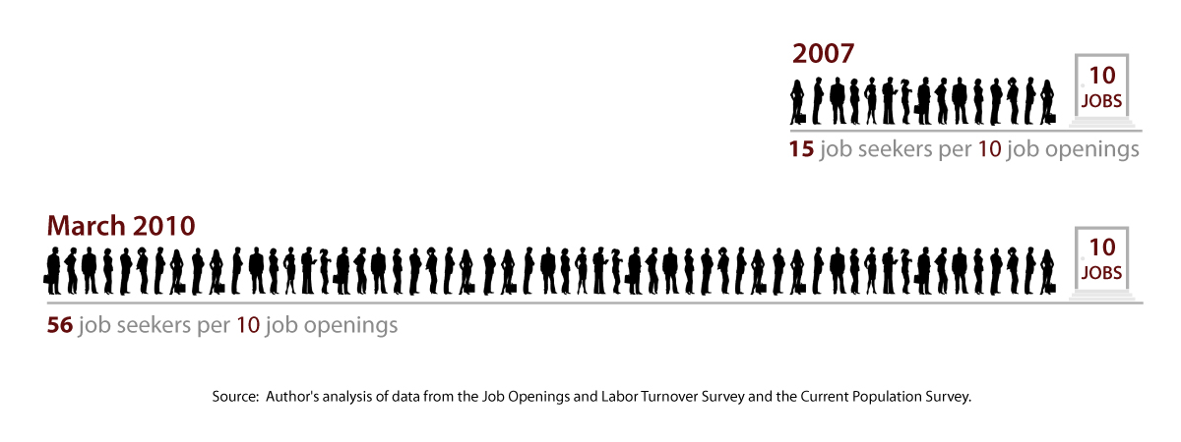
5.6 Job seekers per job opening

Slide 5
Share of unemployed who have been jobless for over six months
Source: Bureau of Labor Statistics

Slide 6
Current UI Benefits
Regular benefits: Maximum of 26 weeks
Plus emergency benefits: Up to 73 additional
weeks, (depending on the unemployment rate
in your state)
Note: Under current law, emergency benefits
begin to phase out next week.

Slide 7
Share of unemployed receiving UI
68.0%
33.6%
Recipients in regular UI programs
Source: EPI analysis of ETA data.

Slide 8
What’s at stake
Source: ETA.

Slide 9
Number of Claimants Impacted by Delay in Extending EUC & EB

Slide 10
For more information
Heidi Shierholz
hshierholz@epi.org
202.533.2560
Economic Policy Institute
1333 H Street, NW
Suite 300, East Tower
Washington, DC 20005-4707
202.775.8810
www.epi.org
Notes:
10

