Slide 1
Economic Impacts of the
KORUS-FTA
Progressive Caucus Briefing
Robert E. Scott, Ph.D.
Economic Policy Institute
February 23, 2011
Notes:
What this presentation will do is update you on the current situation in the labor market, with an emphasis where possible on what’s going on with women and specifically single moms, and give the expected landscape for 2010 and beyond.

Slide 2
Table 1
Projected Impacts of Trade Agreements
(billions of dollars)
 | Exports | Imports | Trade Balance | GDP | Jobs
U.S. International Trade Commission (USITC)
KORUS-max*
Bilateral | 10.9 | 6.9 | 4.0 | 11.9 | negligible
Global | 5.3 | 5.7 | -0.4
US Colombia | 1.1 | 0.5 | 0.6 | 2.5 | minimal/none****
total-USITC** | 6.4 | 6.2 | 0.2 | 14.4 | minimal
Chamber study*** | 40.2 | 0.0 | 40.2 | 44.8 | 338,352
*The ITC KORUS study project a range of trade impacts:
Exports $9.7-10.9 billion, and Imports $6.4-6.9 billion.
**The ITC predicts that the US-Panama TPA would have a "small" impact on the U.S. economy;
it did not estimate the impacts of this agreement on U.S. global trade flows (USITC 2007b). Total-USITC reflects sum of global trade impacts of the KORUS-max scenario and the US-Columbia trade estimates (no global impacts estimated in that study).
***Combined impacts of falure to enact US Korea, Colombia and Panama trade agreements,
including the global impact of the KORUS agreement (only--bilateral U.S. Korea trade is not included)
and the bilateral impact of the U.S.-ColumbiaTrade Promotion Agreement.
****U.S. output (quantity and revenue) of sugar were projected to decline by 0.3%,
and employment of skilled and unskilled labor in this sector is also projected to decline by the 0.3%.
Sources: USITC (2006, and 2007b) and Baughman and Francois (2009), Scott, Robert E. 2010.
Trade policy and job loss; Washington, D.C.: Economic Policy Institute. Working paper #289,
Febraruary 25. http://www.epi.org/publications/entry/trade_policy_and_job_loss/ ; Table updated to reflect global results in USITC March 2010, corrected printing.
U.S. International Trade Commission. 2010. "U.S. Korea Free Trade Agreement: Potential Economy-
wide and Selected Sectoral Effects." Washington, D.C.: U.S. International Trade Commission.
Publication 3949. Corrected printing. March 2010. http://www.usitc.gov/publications/docs/pubs/2104F/pub3949.pdf

Slide 3
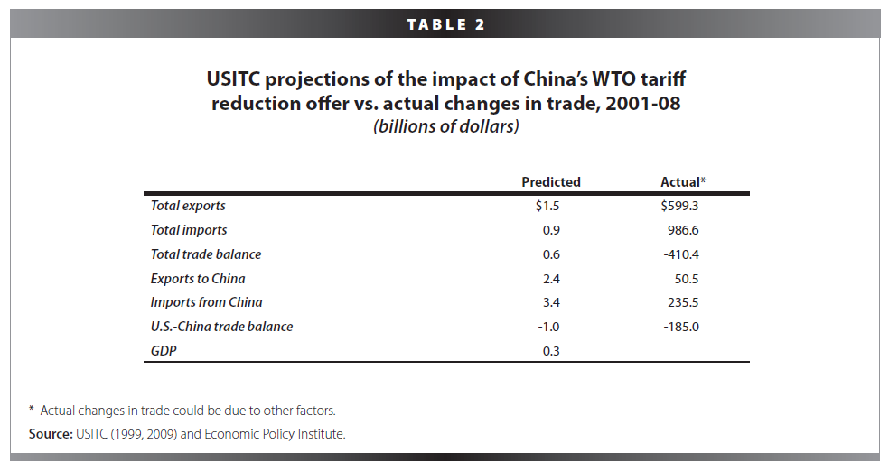
USITC projections versus actual

Slide 4
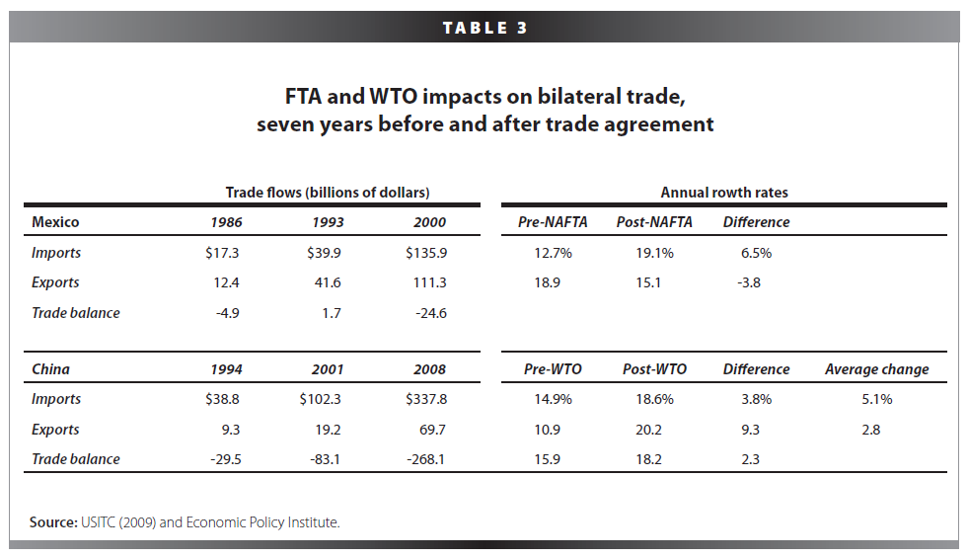
FTA and WTO impacts

Slide 5
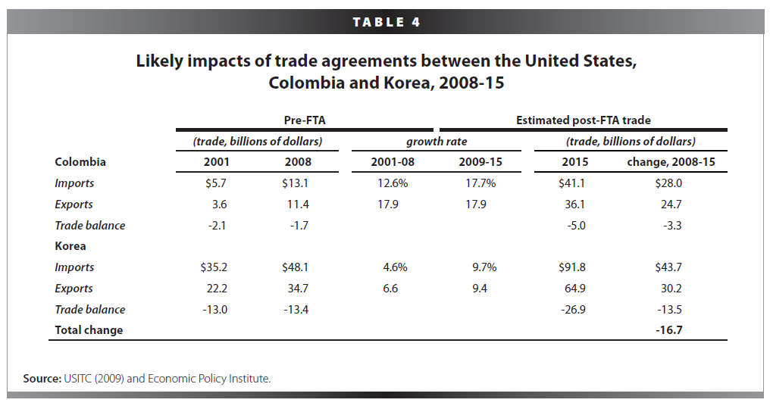
Likely impacts of trade agreements with Colombia and Korea

Slide 6
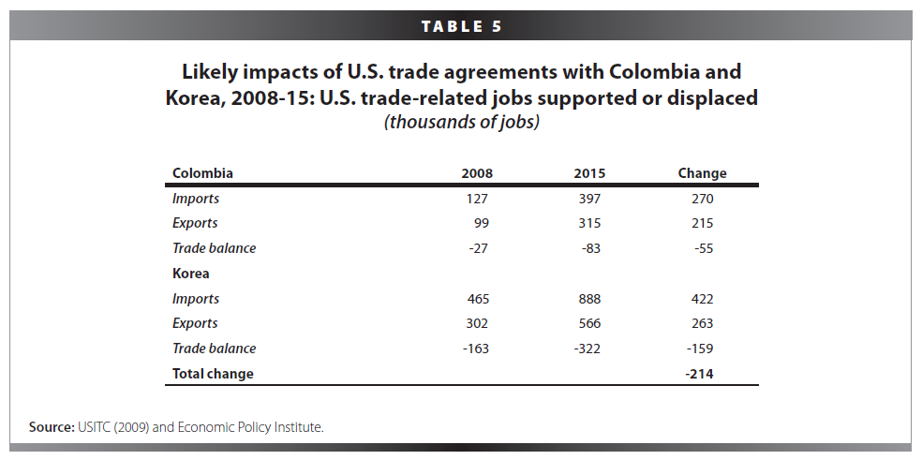
Trade agreements with Colombia and Korea: Jobs impact

Slide 10
Lessons from NAFTA
U.S. Mexico Trade was balanced in 1993, prior to the agreement
The U.S. has experience rapidly growing trade deficits and job displacement since NAFTA was implemented
Job losses are concentrated in motor vehicles and electronics
Oil is a big part of trade with Mexico, but has only minor impacts on employment.

Slide 11
NAFTA takes effect 1/1/94

Slide 12
U.S. Mexico trade and job displacement, 1997-2010
U.S. trade with Mexico ($billions, nominal)
 |  |  |  |  | Changes in: ($billions) |  |  |  | Percent change
 | 1997 | 2000 | 2007 | 2010 | 1997-2000 | 2000-07 | 2007-10 |  | 1997-2010
U.S. domestic exports* | $68.4 | $100.4 | $119.4 | $131.6 | $32.0 | $18.9 | $12.2 |  | 92%
U.S. imports for consumption | 85.0 | 134.7 | 210.2 | 228.8 | 49.7 | 75.4 | 18.7 |  | 169%
U.S. trade balance | -16.6 | -34.3 | -90.8 | -97.2 | -17.7 | -56.5 | -6.4 |  | 485%
Average annual change in the trade balance |  |  |  |  | -5.9 | -8.1 | -2.1 |  | 15%
U.S. trade-related jobs supported and displaced (thousands of jobs)
 |  |  |  |  | Changes in: (thousands of jobs) |  |  |  | Percent change
 | 1997 | 2000 | 2007 | 2010 | 1997-2000 | 2000-07 | 2007-10 |  | 1997-2010
U.S. domestic exports | 523.7 | 767.1 | 780.7 | 791.9 | 243.4 | 13.6 | 11.2 |  | 51%
U.S. imports for consumption-jobs displaced | 626.3 | 966.7 | 1,347.2 | 1,474.8 | 340.4 | 380.5 | 127.6 |  | 135%
U.S. trade deficit-net jobs lost | 102.6 | 199.6 | 566.5 | 682.9 | 97.0 | 366.9 | 116.4 |  | 566%
Average annual job displacement |  |  |  |  | 32.3 | 52.4 | 38.8 |  | 10%
Source: EPI analysis of Census Bureau, ITC, and BLS data
Preliminary analysis: NOT FOR QUOTATION OR DISTRIBUTION

Slide 13
Change in net jobs created or displaced by industry, 2010
 | Industry total* | Share of total
Agriculture, forestry, fisheries | 8,200 | -1.2%
Mining | -21,000 | 3.1%
Oil and gas | -17,600 | 2.6%
Minerals and ores | -3,300 | 0.5%
Utilities | -2,000 | 0.3%
Construction | -11,100 | 1.6%
Manufacturing | -415,000 | 60.8%
Non-durable goods | -22,200 | 3.3%
Food and kindred products | 5,700 | -0.8%
Beverage and tobacco products | -3,600 | 0.5%
Textiles and fabrics | 6,400 | -0.9%
Textile mill products | -3,400 | 0.5%
Apparel and accessories | -22,100 | 3.2%
Leather and allied products | -5,200 | 0.8%
Industrial supplies | 3,200 | -0.5%
Wood products | -1,500 | 0.2%
Paper | 4,800 | -0.7%
Printed matter and related products | -2,500 | 0.4%
Petroleum and coal products | 1,700 | -0.2%
Chemicals | 13,100 | -1.9%
Plastics and rubber products | -2,300 | 0.3%
Nonmetallic mineral products | -10,000 | 1.5%
Source: EPI analysis of Census Bureau, ITC, and BLS data
Preliminary analysis: NOT FOR QUOTATION OR DISTRIBUTION

Slide 14
Change in net jobs created or displaced by industry, 2010
(Continued)
 | Industry total* | Share of total
Durable goods | -396,000 | 58.0%
Primary metal | -22,900 | 3.4%
Fabricated metal products | -39,200 | 5.7%
Not specified metal industries | 0 | 0.0%
Machinery, except electrical | -7,200 | 1.1%
Computer and electronic parts | -150,300 | 22.0%
Computer and peripheral equipment | -27,600 | 4.0%
Communications, audio and video equipment | -82,800 | 12.1%
Navigational, measuring, electromedical, and control instruments | -14,900 | 2.2%
Semiconductor and other electronic components & magnetic and optical media production | -24,900 | 3.6%
Electrical equipment, appliances, and component | -38,600 | 5.7%
Transportation equipment | -105,500 | 15.4%
Motor vehicles and parts | -108,000 | 15.8%
Aerospace product and parts | 2,000 | -0.3%
Railroad, ship, and other transportation equipment | 400 | -0.1%
Furniture and fixtures | -9,600 | 1.4%
Miscellaneous manufactured commodities | -22,300 | 3.3%
Source: EPI analysis of Census Bureau, ITC, and BLS data
Preliminary analysis: NOT FOR QUOTATION OR DISTRIBUTION

Slide 15
Jobs lost through imports, jobs gained through exports, and net job change, due to trade with Mexico, 2010
Top 12 hardest hit states
 | Import jobs | Export jobs | Net job change | Total employment | Share of total state employment in 2005-07
 |  |  |  |  |  | Rank
Michigan | -80,500 | 36,800 | -43,600 | 4,552,700 | -0.96% | 1
Indiana | -49,500 | 25,000 | -24,400 | 3,000,700 | -0.81% | 2
Kentucky | -25,200 | 13,000 | -12,100 | 1,863,500 | -0.65% | 3
Ohio | -75,100 | 40,200 | -34,900 | 5,412,100 | -0.64% | 4
Tennessee | -35,100 | 18,600 | -16,400 | 2,778,500 | -0.59% | 5
New Hampshire | -8,200 | 4,100 | -4,000 | 694,200 | -0.58% | 6
Illinois | -73,000 | 38,300 | -34,700 | 6,087,800 | -0.57% | 7
Alabama | -24,500 | 13,300 | -11,100 | 1,995,900 | -0.56% | 8
Massachusetts | -33,700 | 16,600 | -17,100 | 3,241,300 | -0.53% | 9
Texas | -113,100 | 57,500 | -55,600 | 10,602,400 | -0.52% | 10
California | -174,200 | 87,700 | -86,500 | 16,565,000 | -0.52% | 11
Wisconsin | -37,200 | 22,700 | -14,500 | 2,849,100 | -0.51% | 12
Source: EPI analysis of Census Bureau, ITC, and BLS data
Preliminary analysis: NOT FOR QUOTATION OR DISTRIBUTION

Slide 16
Links
Snapshot: Free Trade Agreement with Korea will Cost U.S. Jobs. July 1, 2010.
Working paper: Trade Policy and Job Loss. February 25, 2010.
Research Assistance by Anna Turner.

