Slide 1
Sustaining the Recovery: The Role of Federal Aid to State and Local Governments
Iris J. Lav, Senior Advisor
Center on Budget and Policy Priorities
www.cbpp.org
at the Economic Policy Institute
November 19, 2009

Slide 2
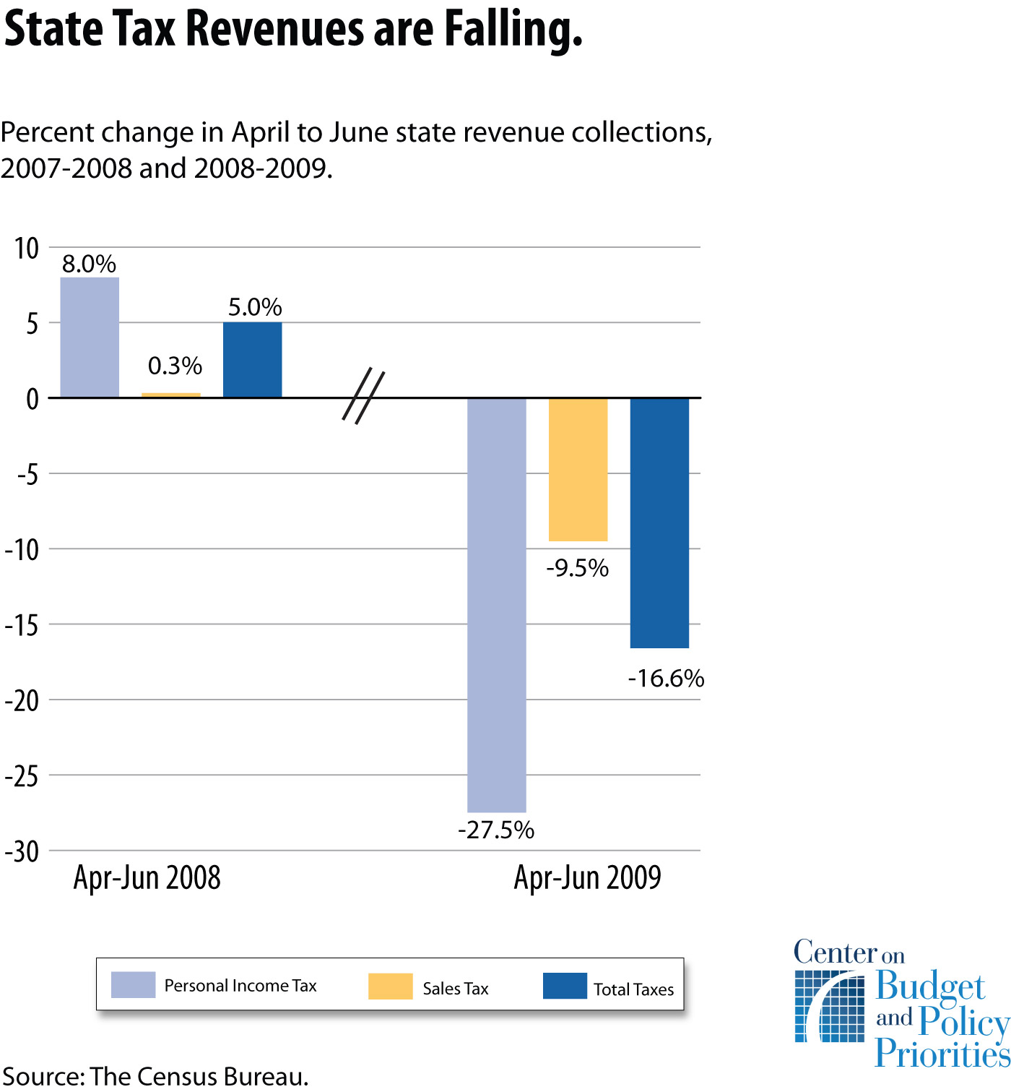

Slide 5
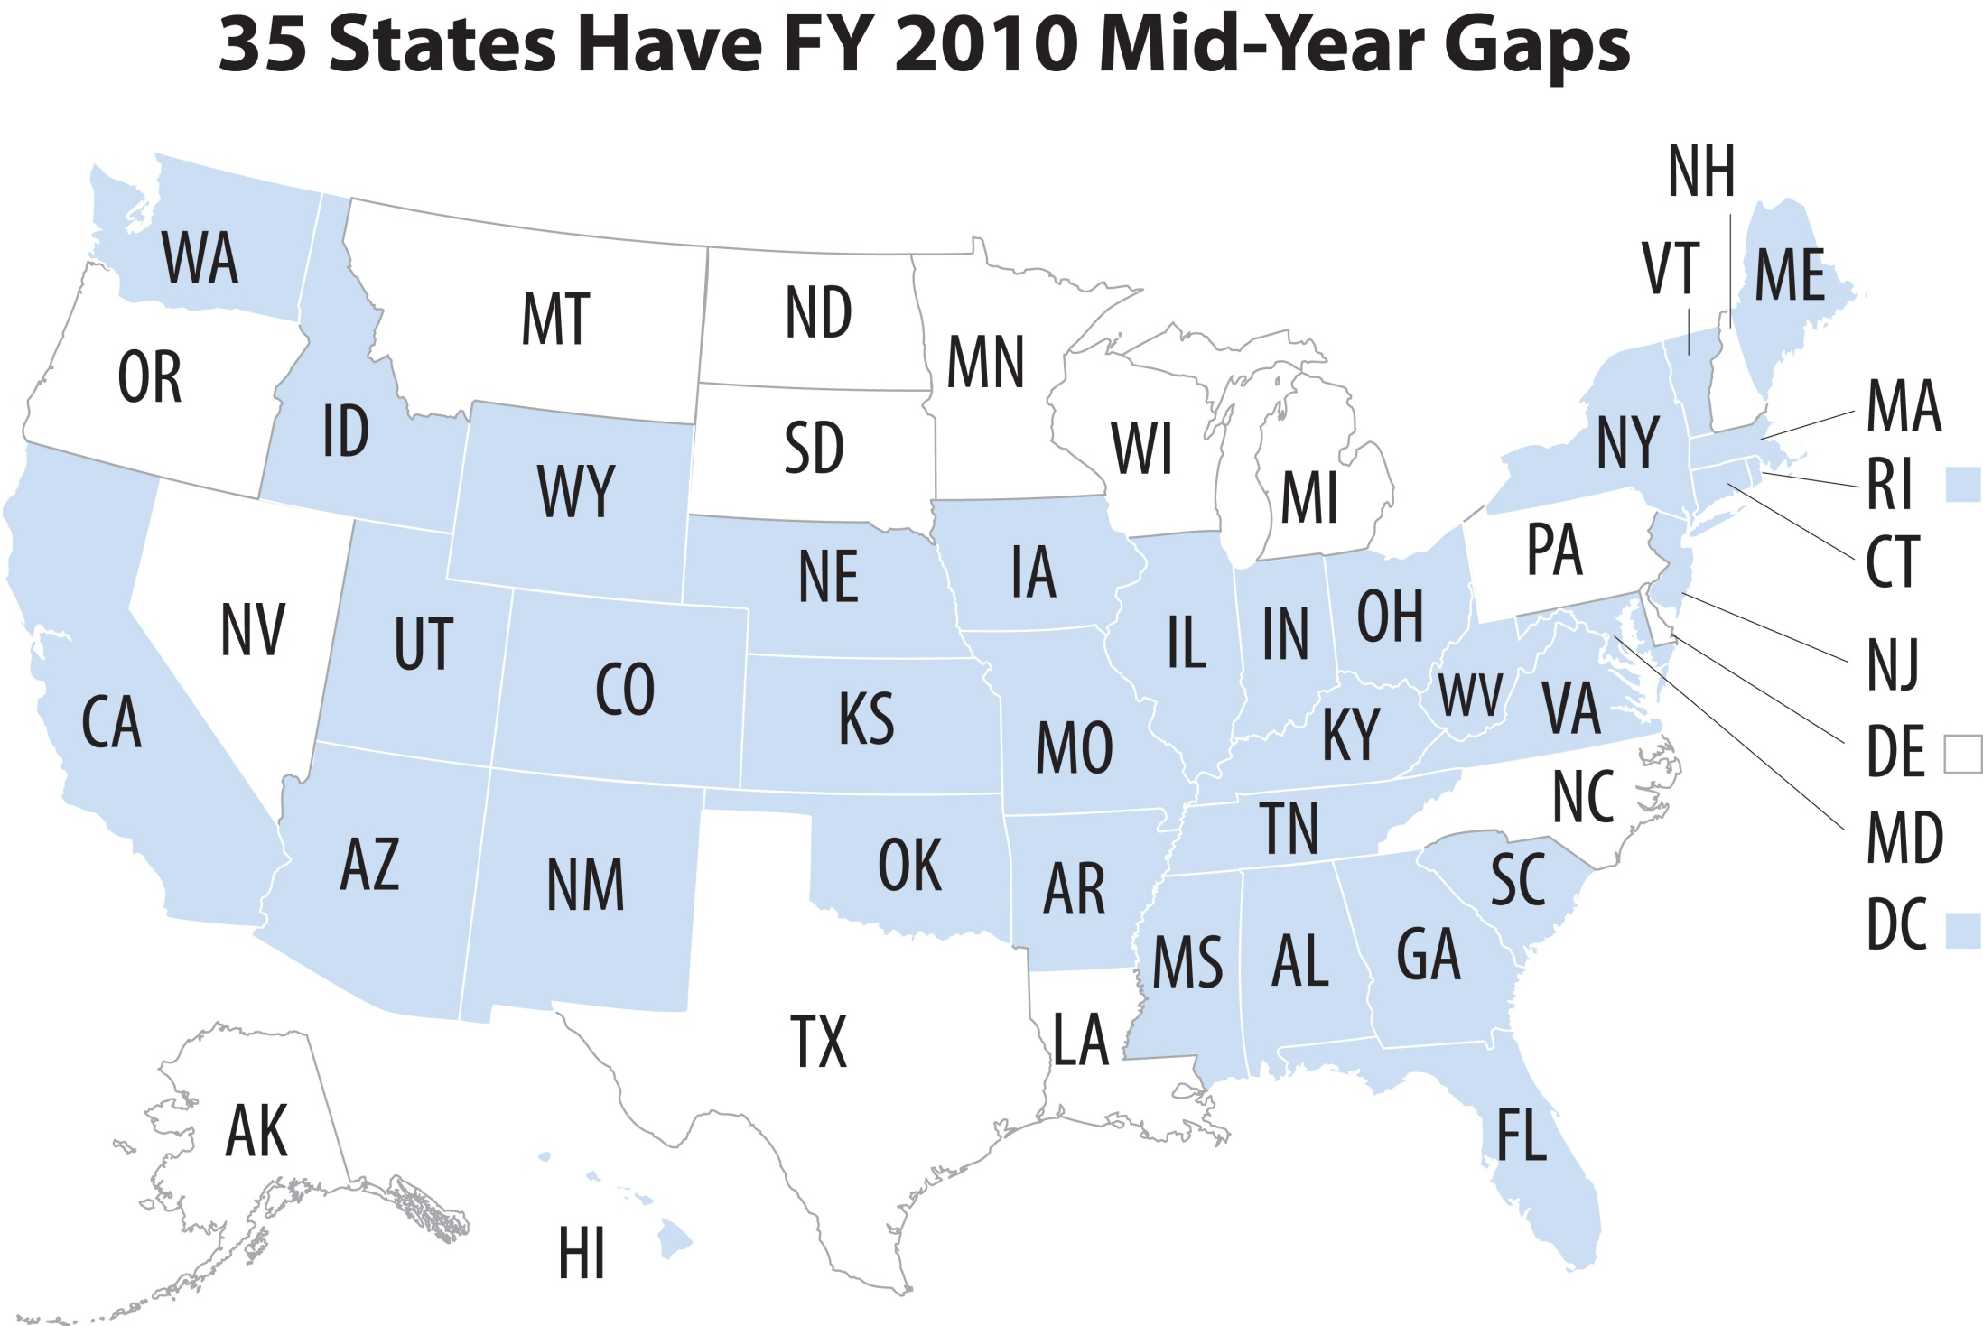

Slide 8
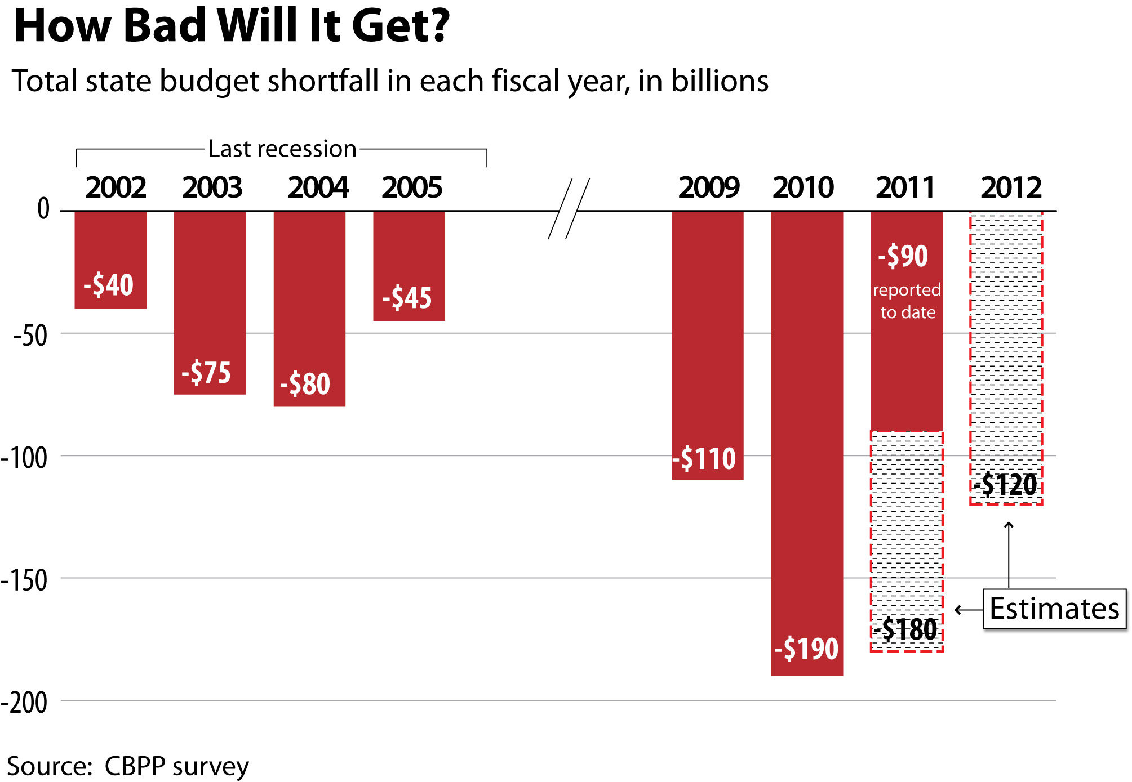

Slide 10
What is At Risk?
$142 billion gap, after ARRA funding
=
0.9 Percent of GDP
=
900,000 JOBS

