Slide 1
Paid Sick Days in the United States
Work-Life Lunch on Family Economic Security
Joint event with The National Partnership for Women & Families
June 29th, 2011
Elise Gould
Health Policy Research Director

Slide 2
Introduction
Today, nearly 40 million Americans do not have paid sick days
Nearly 40% of private sector workers lack access to paid sick time
Access to sick time varies dramatically by job (e.g. industry occupation, wage)
Access to paid sick days is essential for workers and their families
The cost of providing paid sick days is small for employers while the benefits are potentially large

Slide 3
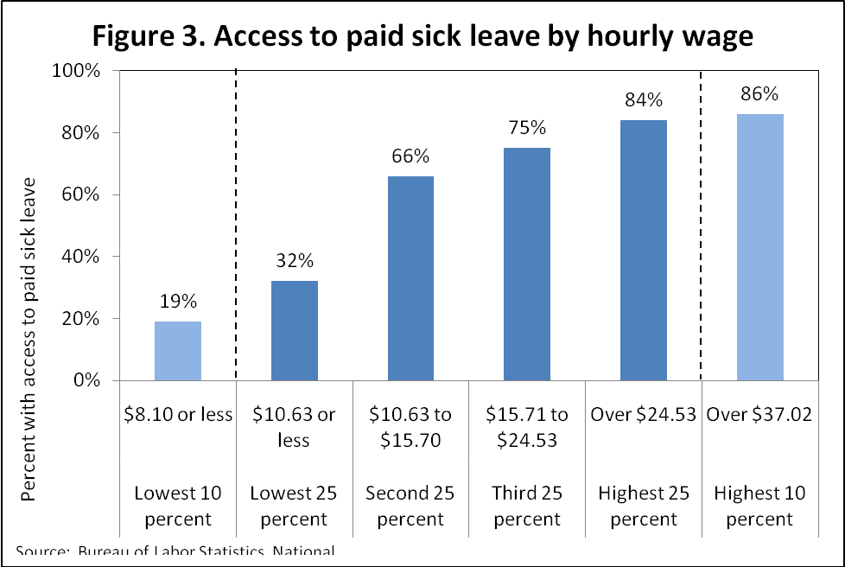
Source: Bureau of Labor Statistics National Compensation Survey.

Slide 4
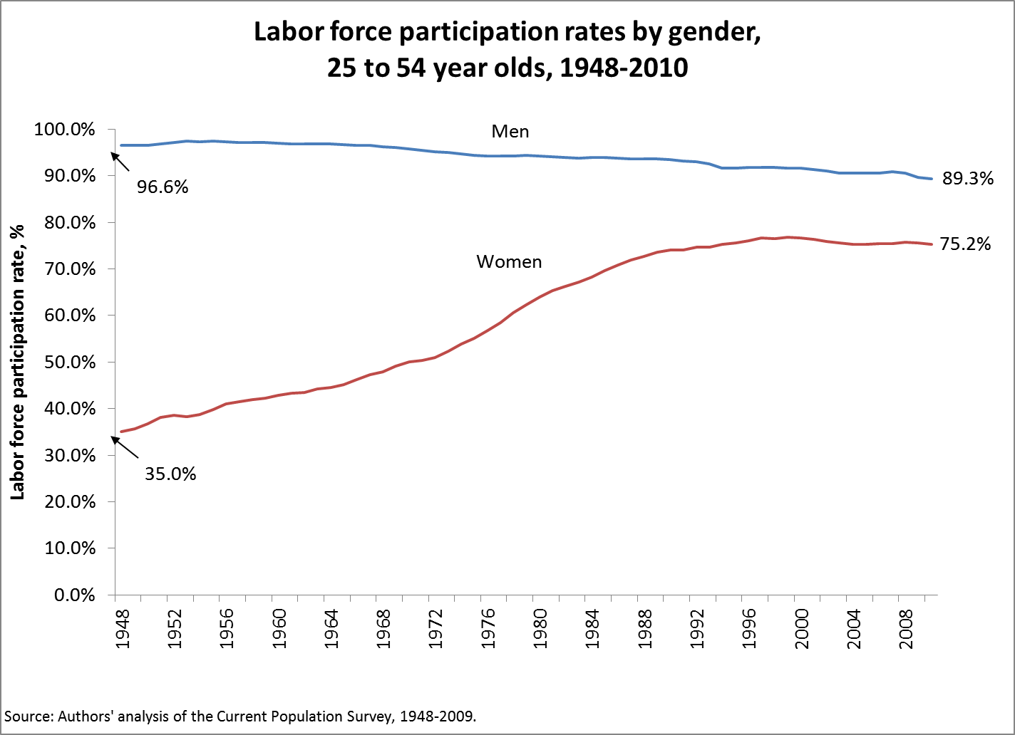

Slide 5
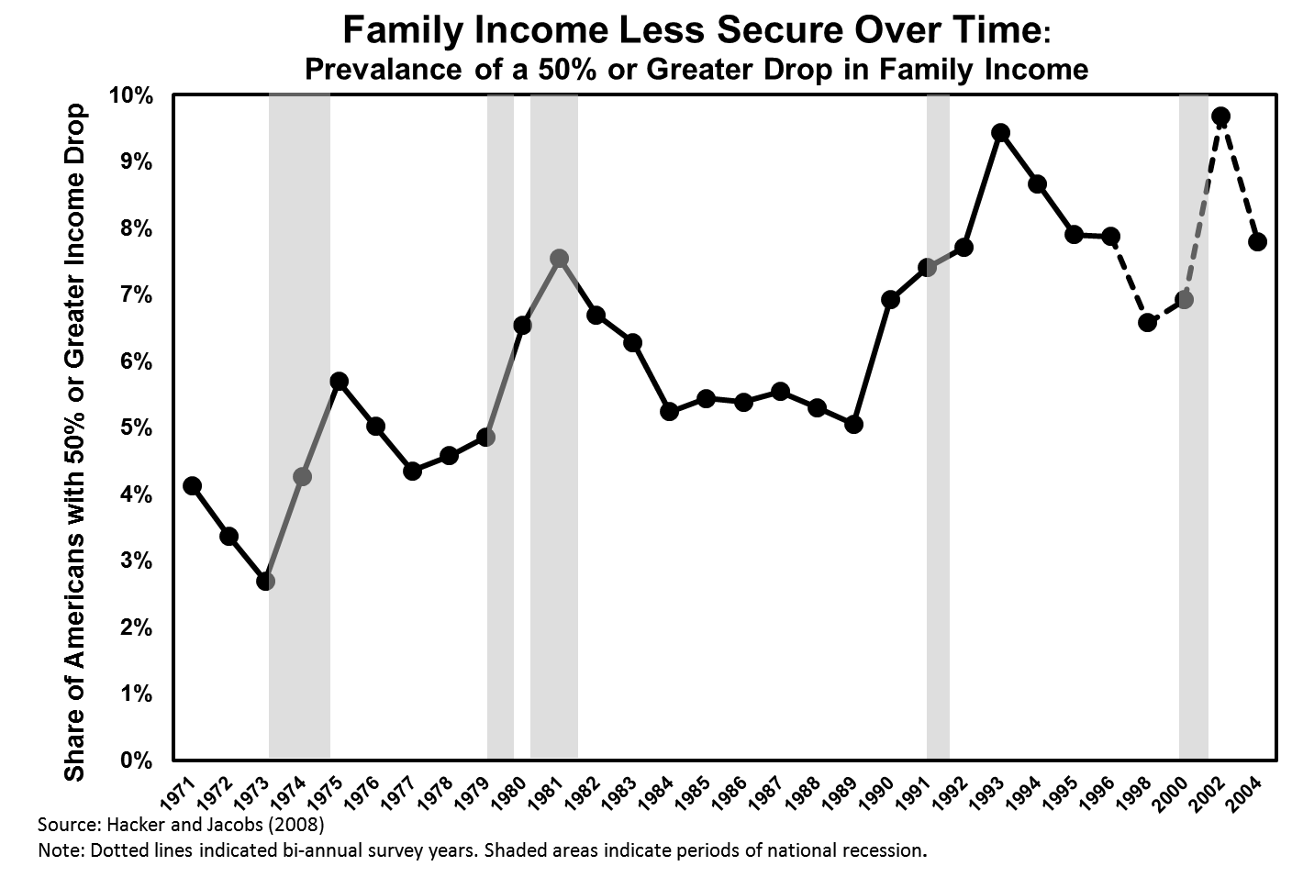
Notes:
5

Slide 6
Why sick time is necessary for families
Sick children can be forced to go to school because their parents cannot miss work
Paid sick days can help guarantee a monthly income, which results in greater economic security.
Losing pay can be a serious blow to a monthly budget
Risk losing employment

Slide 7
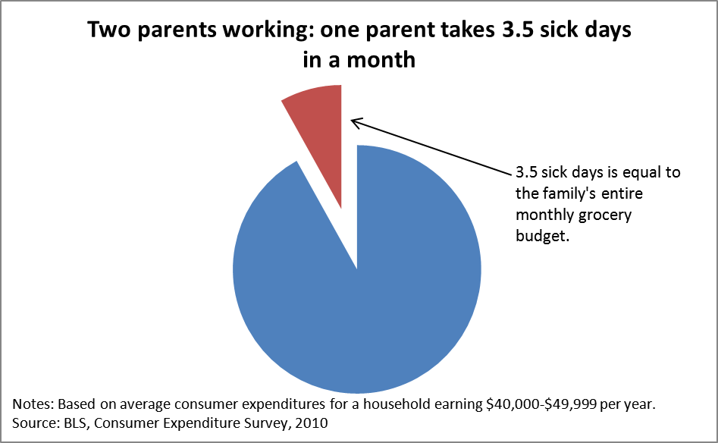
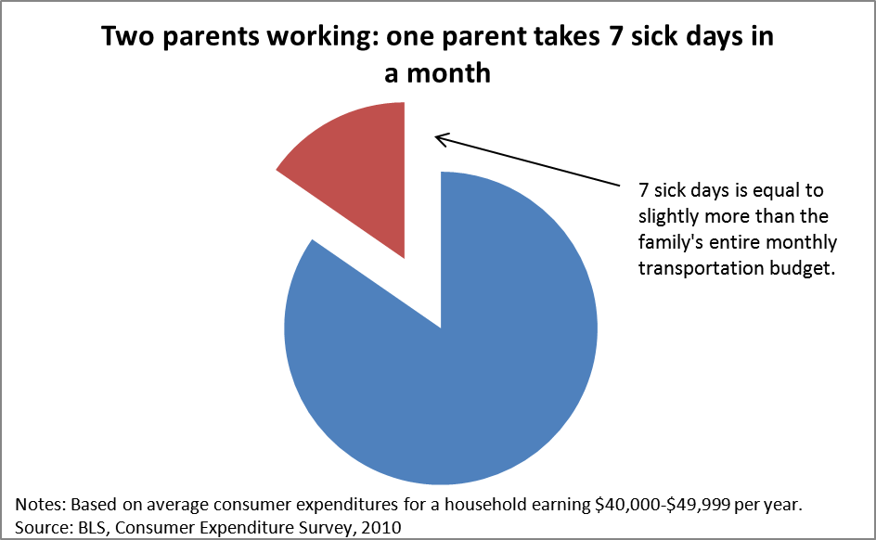
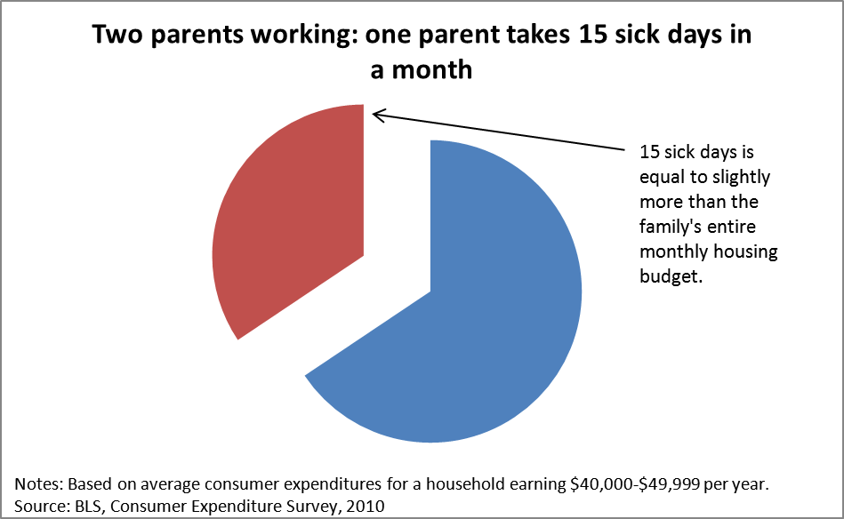

Slide 8
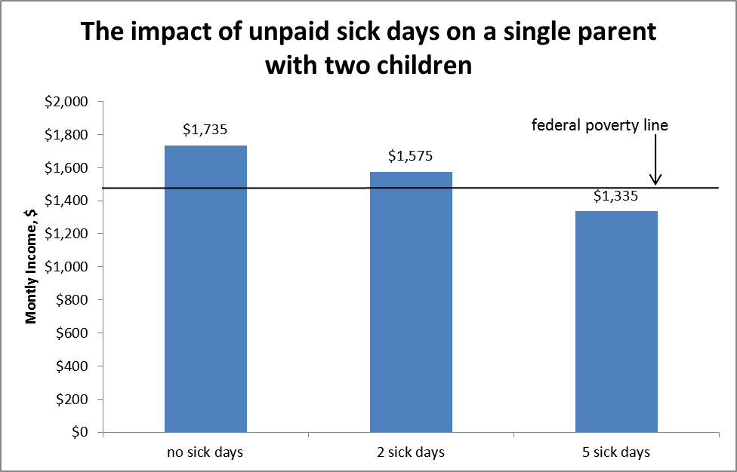

Slide 9
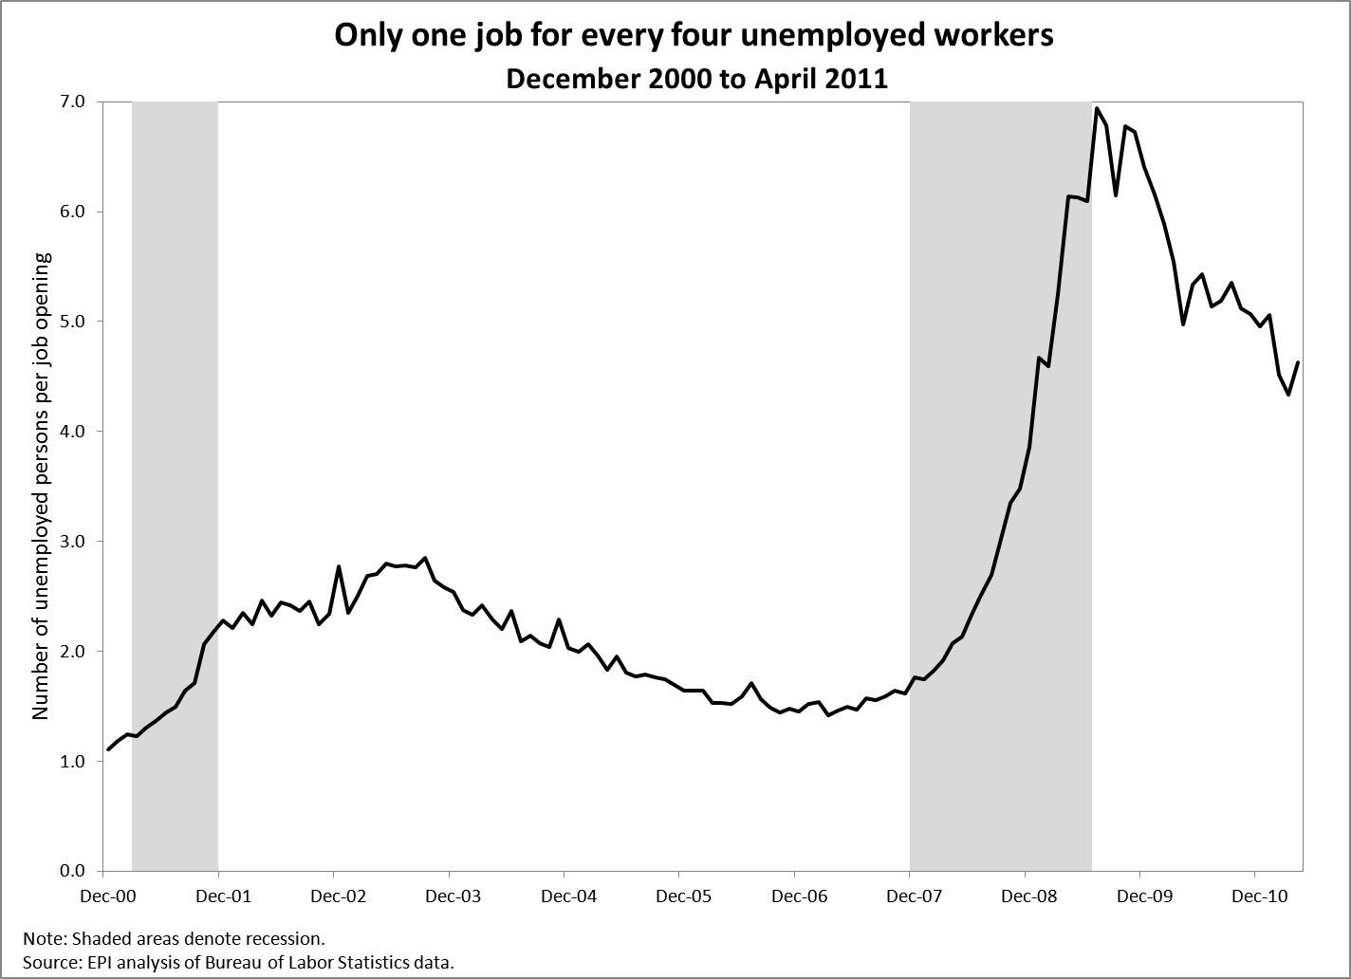
April 2011 4.6

Slide 10
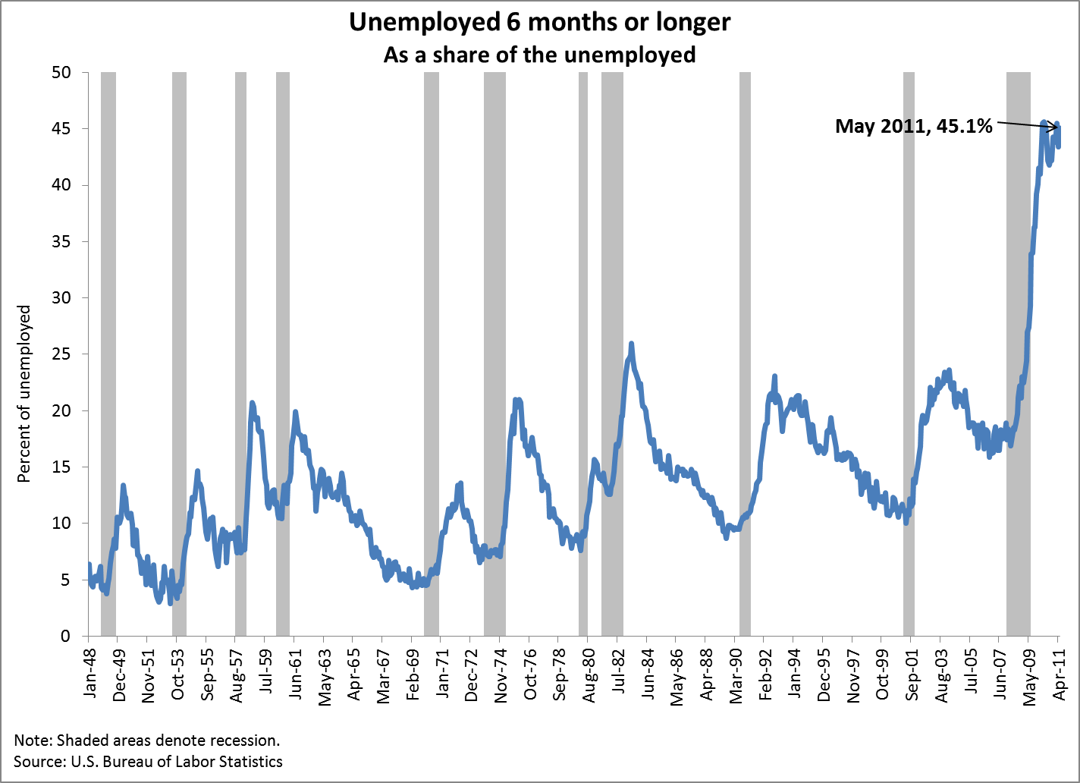

Slide 11
Costs and Benefits for Employers
Benefits
Reduced worker turnover
Turnover is highly costly to employers (e.g. training and hiring)
Sick pay can increase loyalty
Reduced worker “presenteeism”
Workers show up to work while sick and have greatly reduced productivity
Sick workers can spread illness
These benefits may amount to more than the cost of providing sick pay
Costs
The costs to businesses are shown to be a very small percentage of total sales
A case study of businesses in Connecticut provides this evidence

Slide 12
Connecticut Case Study
Hall and Gould (2011) modeled the costs and benefits of proposed sick pay legislation in Connecticut.
The proposal included the following:
An employee earns one hour of sick time for every 40 hours worked
Up to a maximum of 40 hours per year (5 days)
Applies only to employers with 50 or more employees
Estimated costs
Total sales by industry
Share of sales devoted to payroll
Increase in payroll due to paid sick days proposal
Maximum days taken
Conditional on historical average days
Account for current coverage rates by industry and firm size

Slide 13
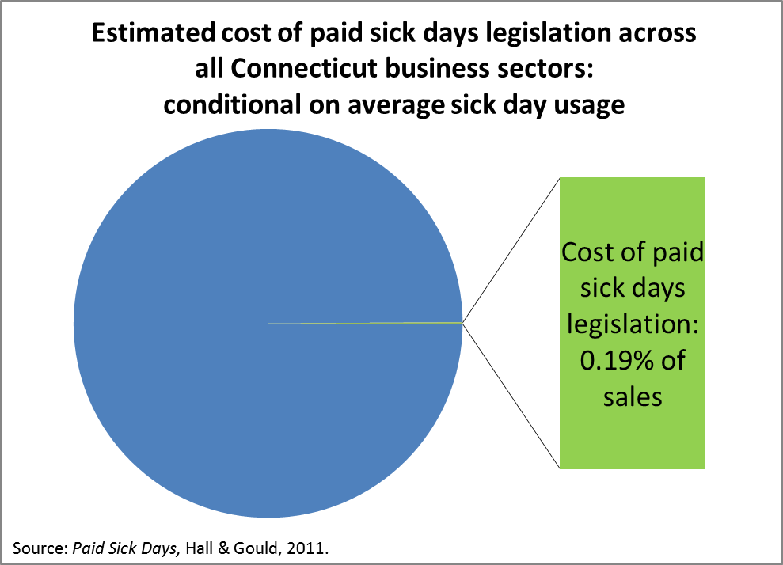
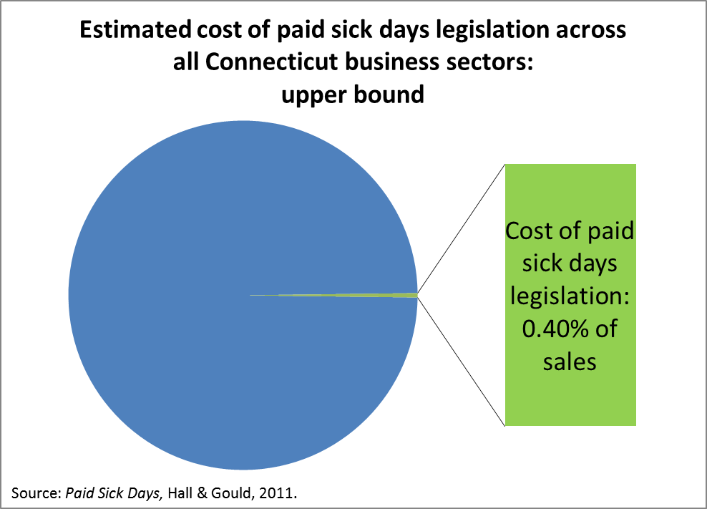
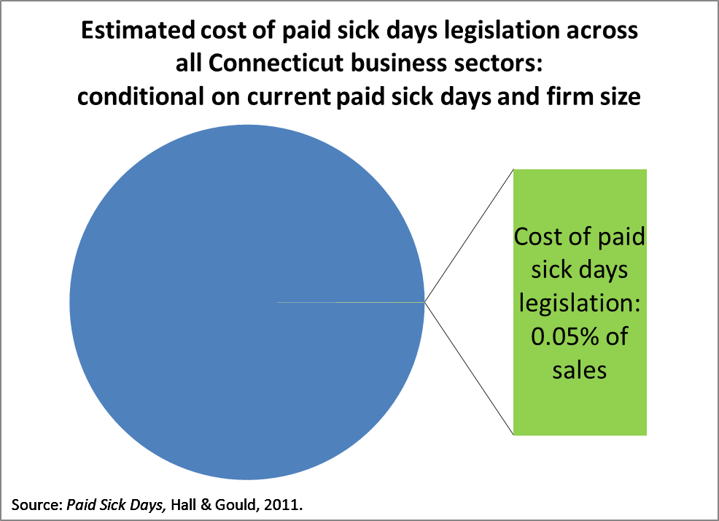

Slide 14
Conclusion
Access to paid sick time is essential for American workers and their families
The cost of providing sick time is low for employers and the benefits are potentially large

