Slide 1
Economic Policy Institute Dire States State and Local Budget Relief Needed to Prevent Job Losses and Ensure a Robust Recovery Ethan Pollack Economic Policy Institute November 19, 2009 epollack@epi.org
Notes:
Talk about two things: (1) Local shortfalls are huge and a sleeper problem, and (2) Most of the jobs lost by the budget cuts necessary to close the shortfall will be in the private sector

Slide 2
Source: BEA

Slide 3
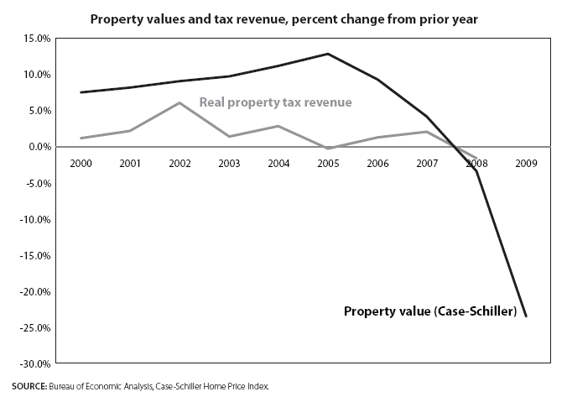
Notes:
Real estate bubble bursting
-Massive devaluation, 30% from peak
-Other recessions experienced much less: 1990-91 recession had a 3% drop

Slide 4
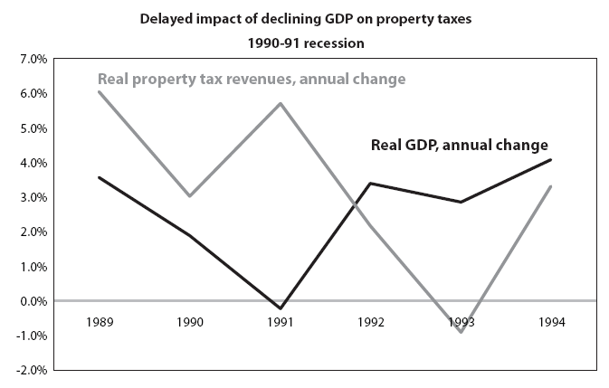
Notes:
Lag effect
So far we’ve only seen modest fall in

Slide 5
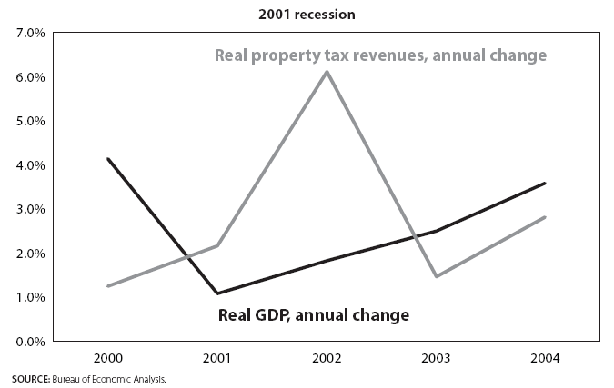

Slide 6
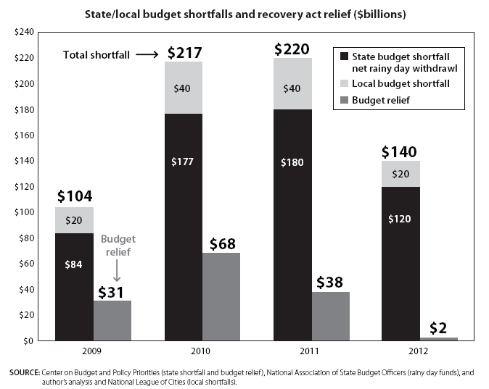

Slide 7
