Slide 1
The State of Working America, 12th Edition Lawrence Mishel, Josh Bivens, Elise Gould, Heidi Shierholz Economic Policy Institute Cornell University Press September 2012

Slide 2
Main findings we’ll discuss
A Lost Decade of income growth for low and middle-income Americans has already happened
Another Lost Decade is in the pipeline, unless policy changes to combat high unemployment much more aggressively
Rising inequality has been the primary barrier to income growth for the last generation of low and middle-income families/households
The fingerprints of intentional policy decisions are all over this upward redistribution

Slide 3
America’s broad middle class has already suffered a ‘Lost Decade’

Slide 4
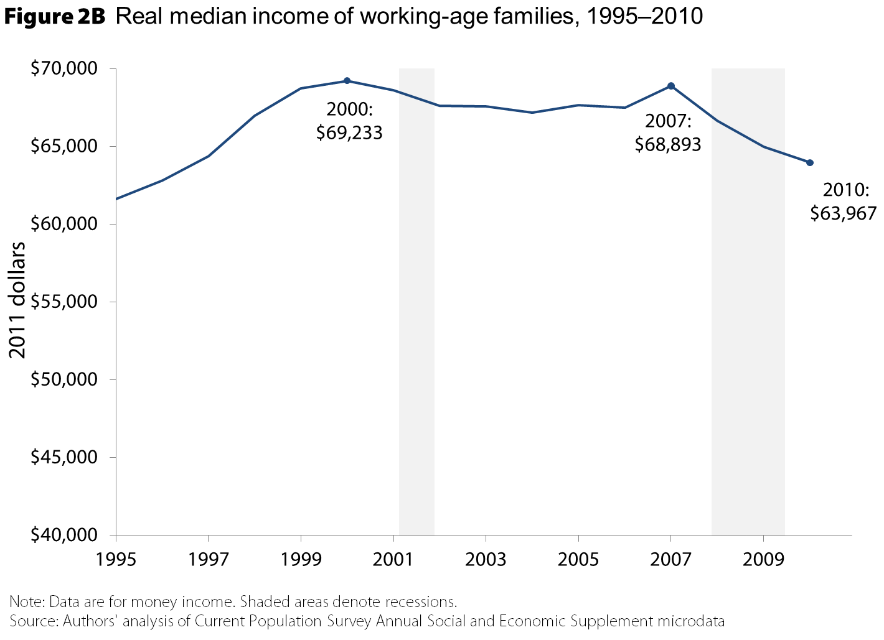

Slide 5
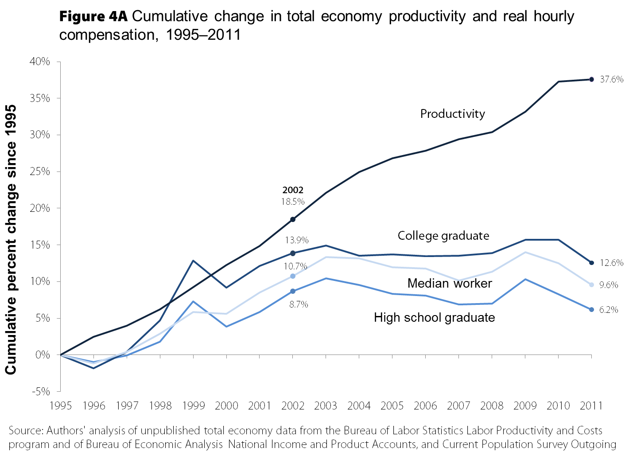

Slide 6
…and faces the threat of another ‘Lost Decade’

Slide 7
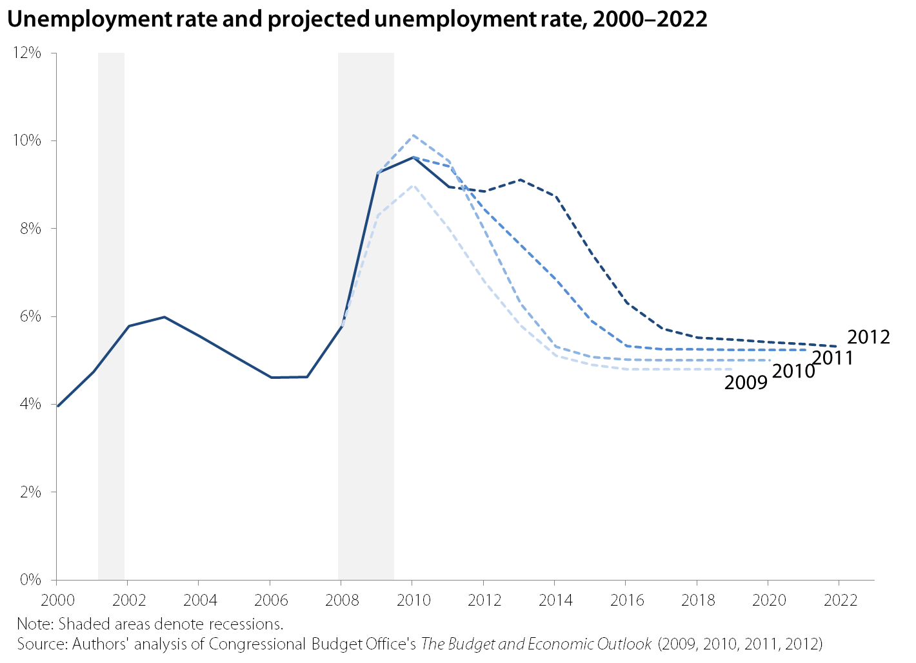

Slide 8
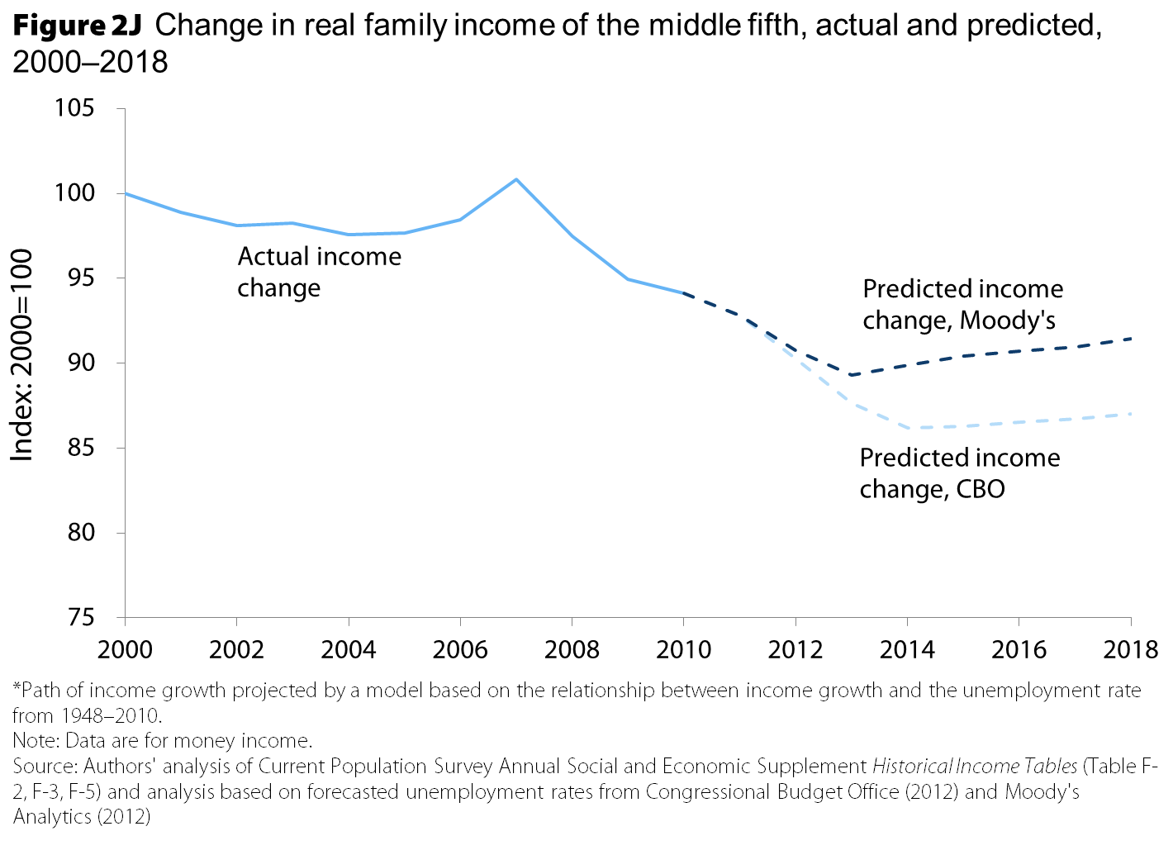

Slide 9
Rising inequality blocked wage and income growth for most of the last generation of Americans…. First we’ll show the trends…

Slide 10
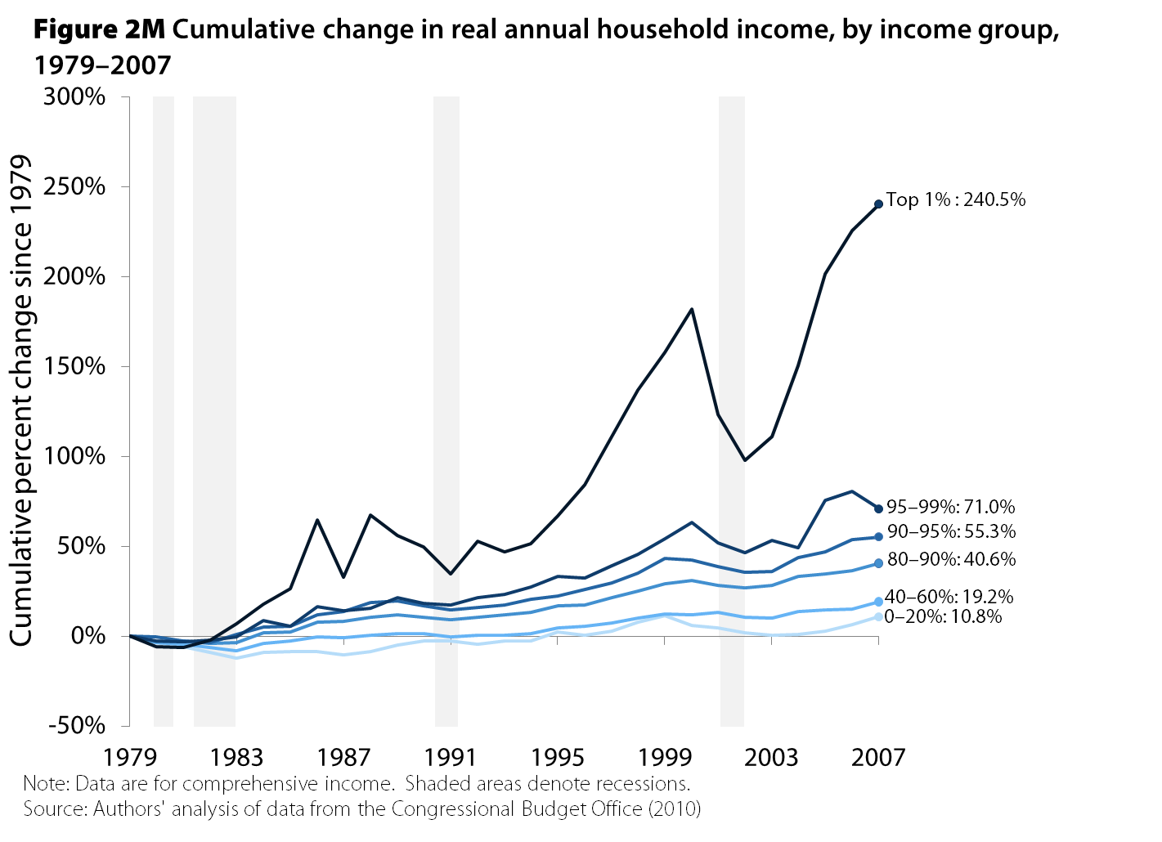

Slide 11
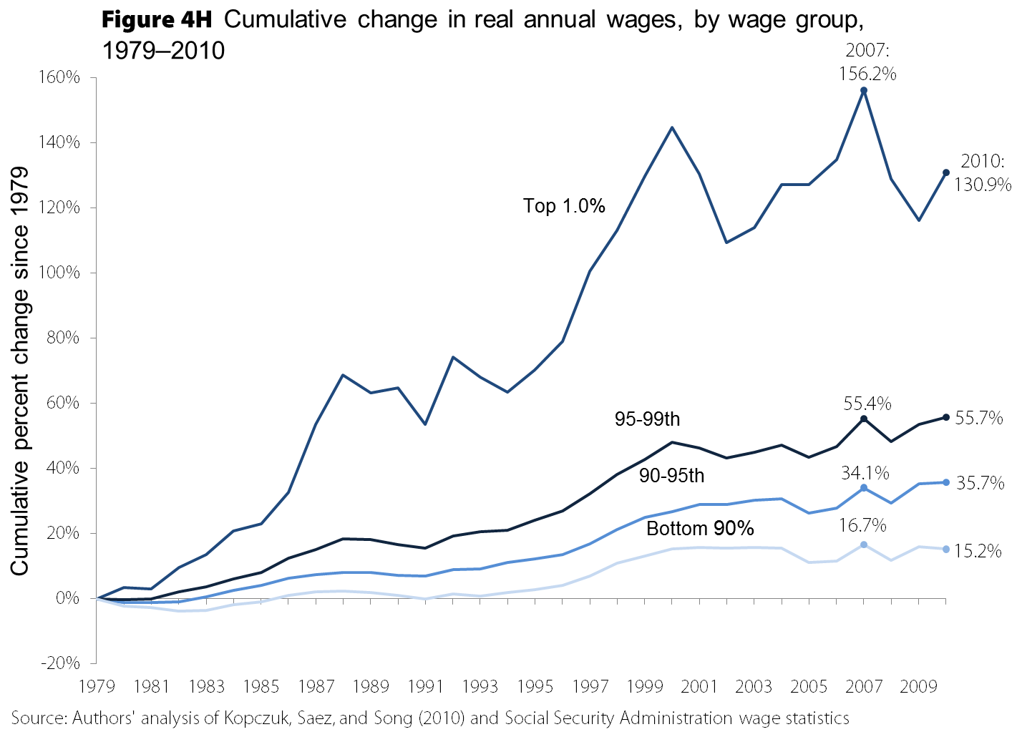

Slide 12
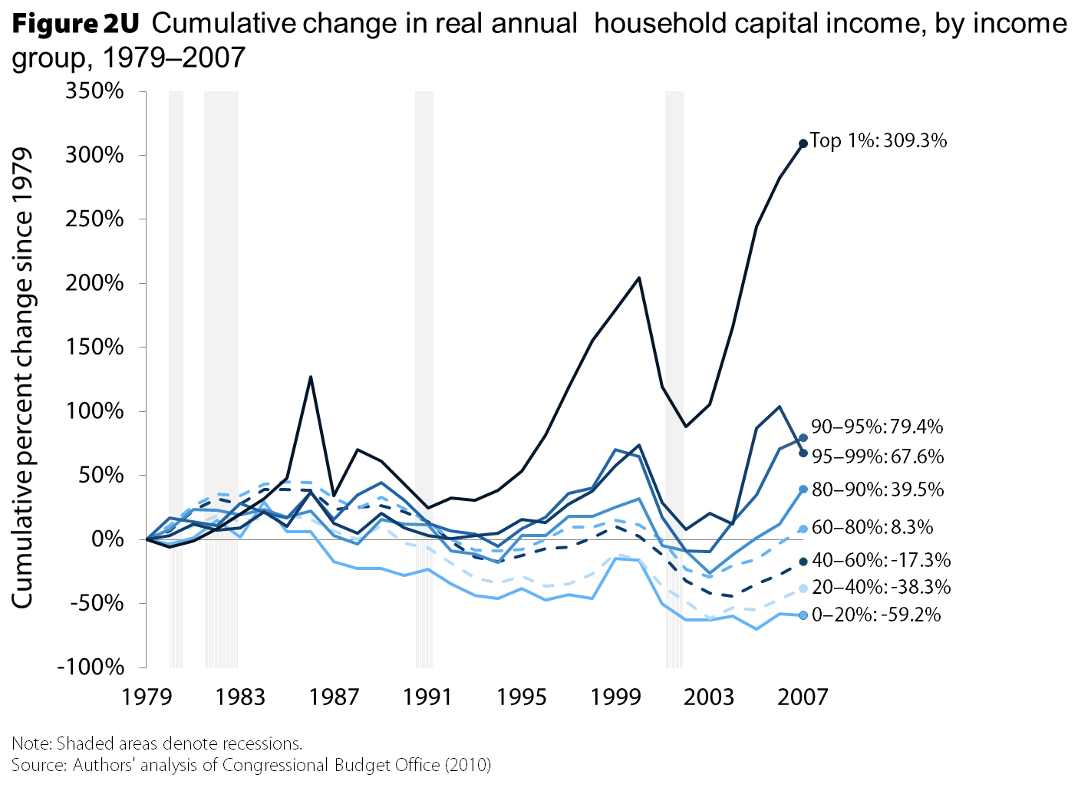

Slide 13
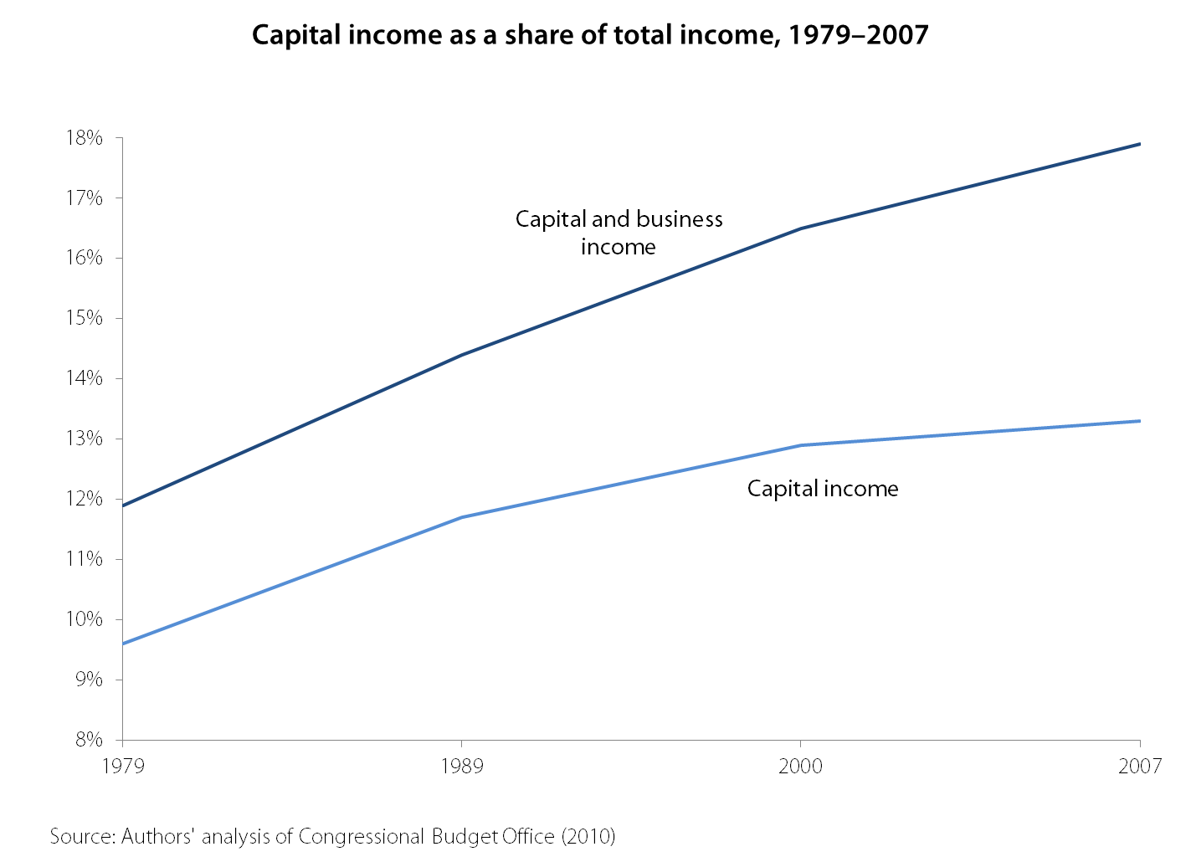

Slide 14
Now the consequences of rising inequality…

Slide 15
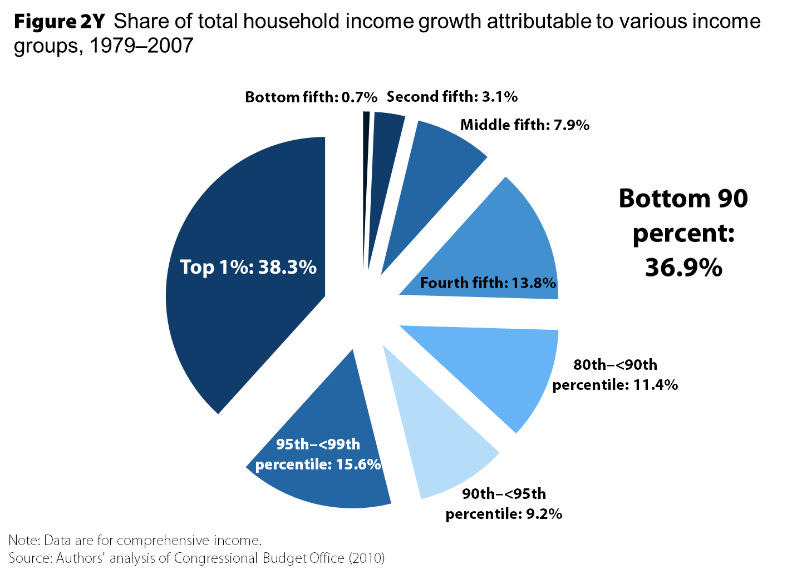

Slide 16
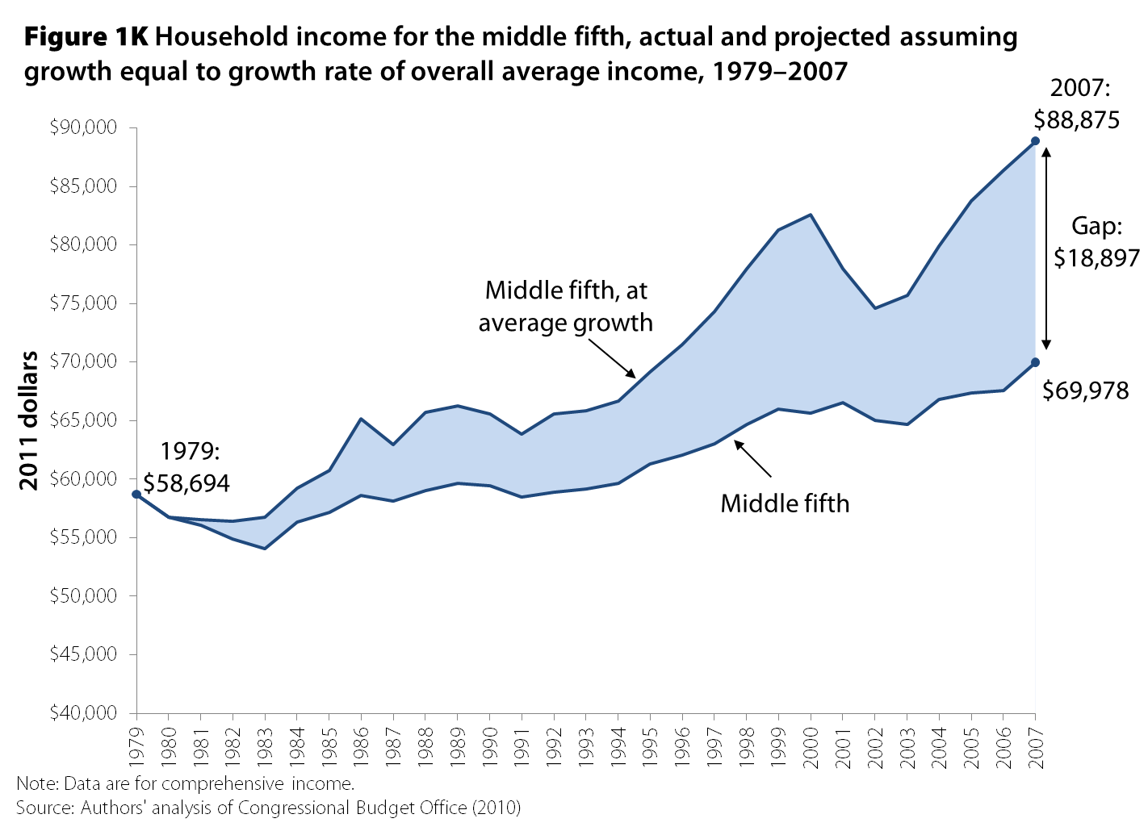

Slide 17
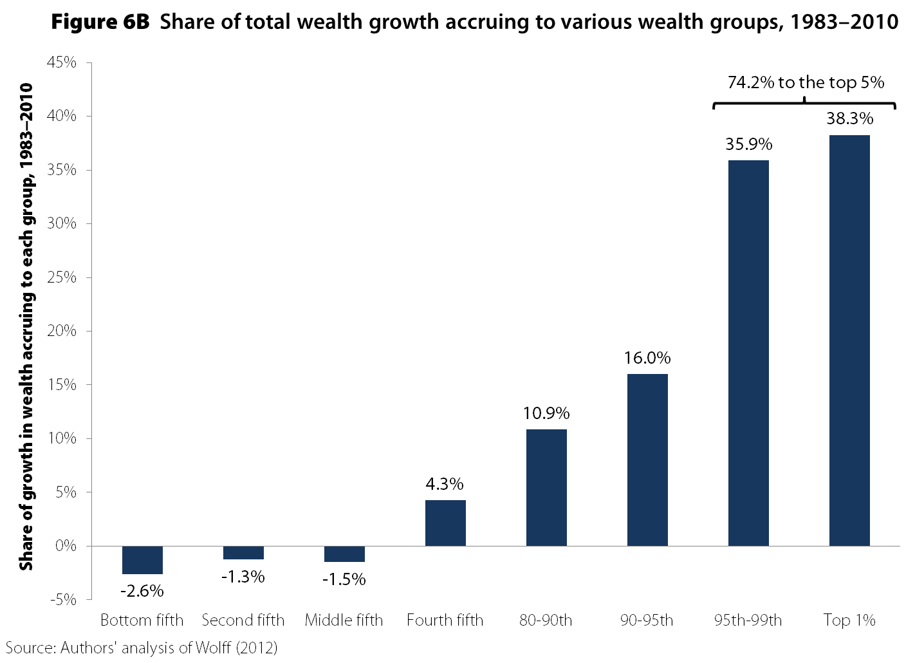

Slide 18
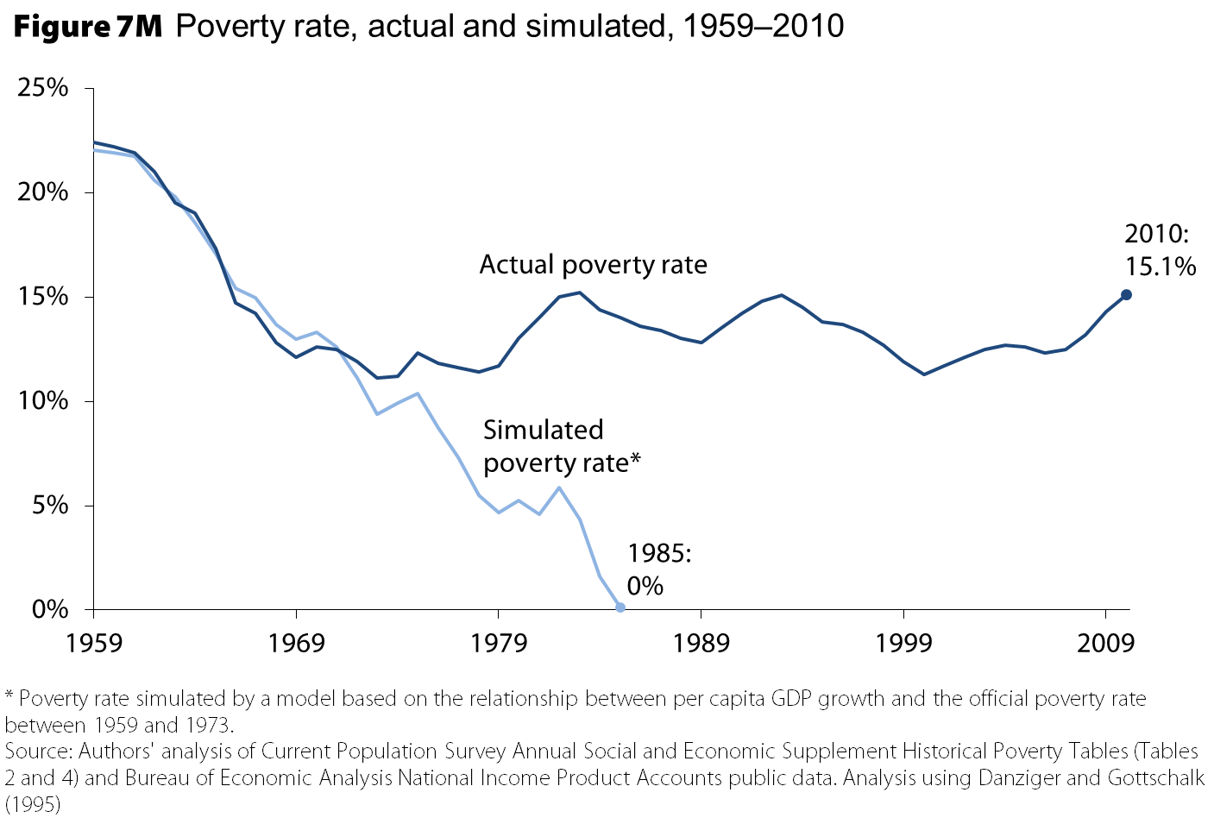

Slide 19
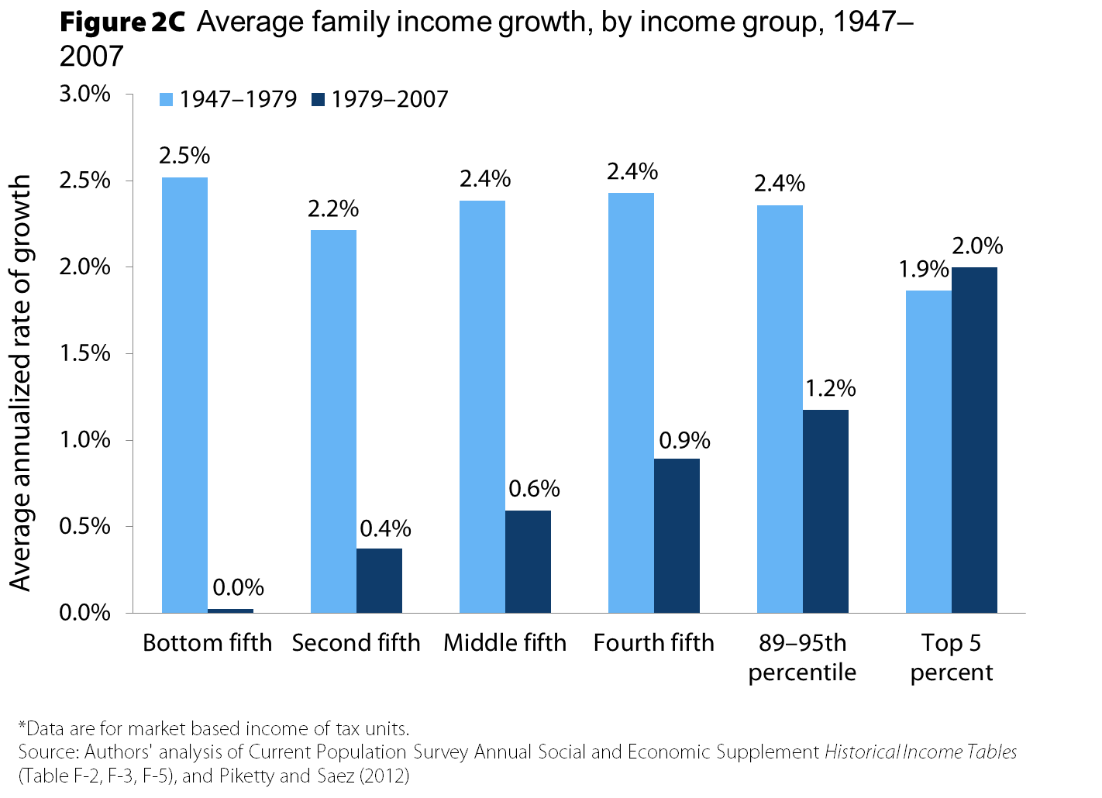

Slide 20
The fingerprints of intentional policy decisions are all over this increased inequality of wages and incomes

Slide 21
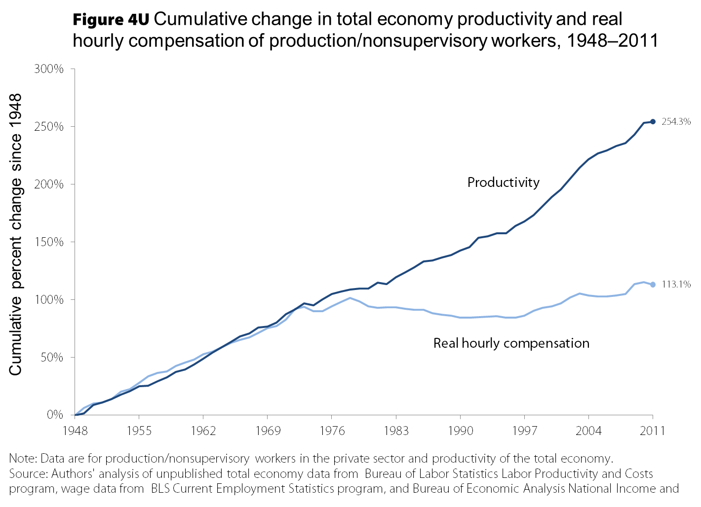

Slide 22
Illustrating policy’s impact by examining three “wage-gaps”
Top 1% wages vs. everybody else, grew continuously 1979-2011 except during stock declines
CEO/executive compensation
Expanded and increasingly highly-paid finance
Middle/bottom (50/10 wage gap), only grew in 1980s
Minimum wage
Unemployment
Top vs. middle (95/50 wage gap), grew continuously 1979-2011
Unemployment
Globalization
Deunionization
Industry deregulation (trucking, airline, etc.)/privatization
Eroded labor standards/norms more generally
Not: health care costs; Skills/education deficit

Slide 23
Explaining top wages

Slide 24
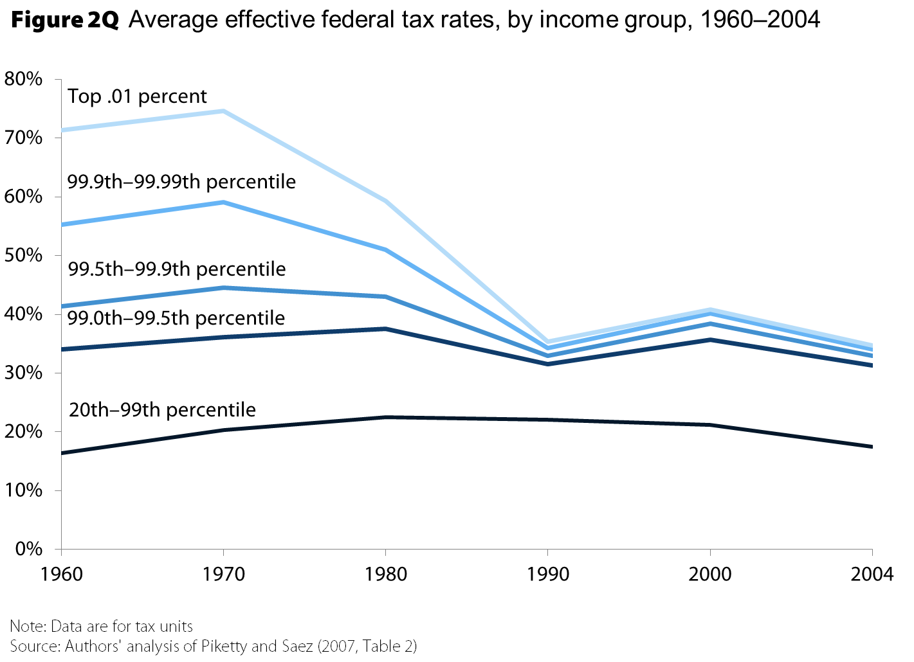

Slide 25
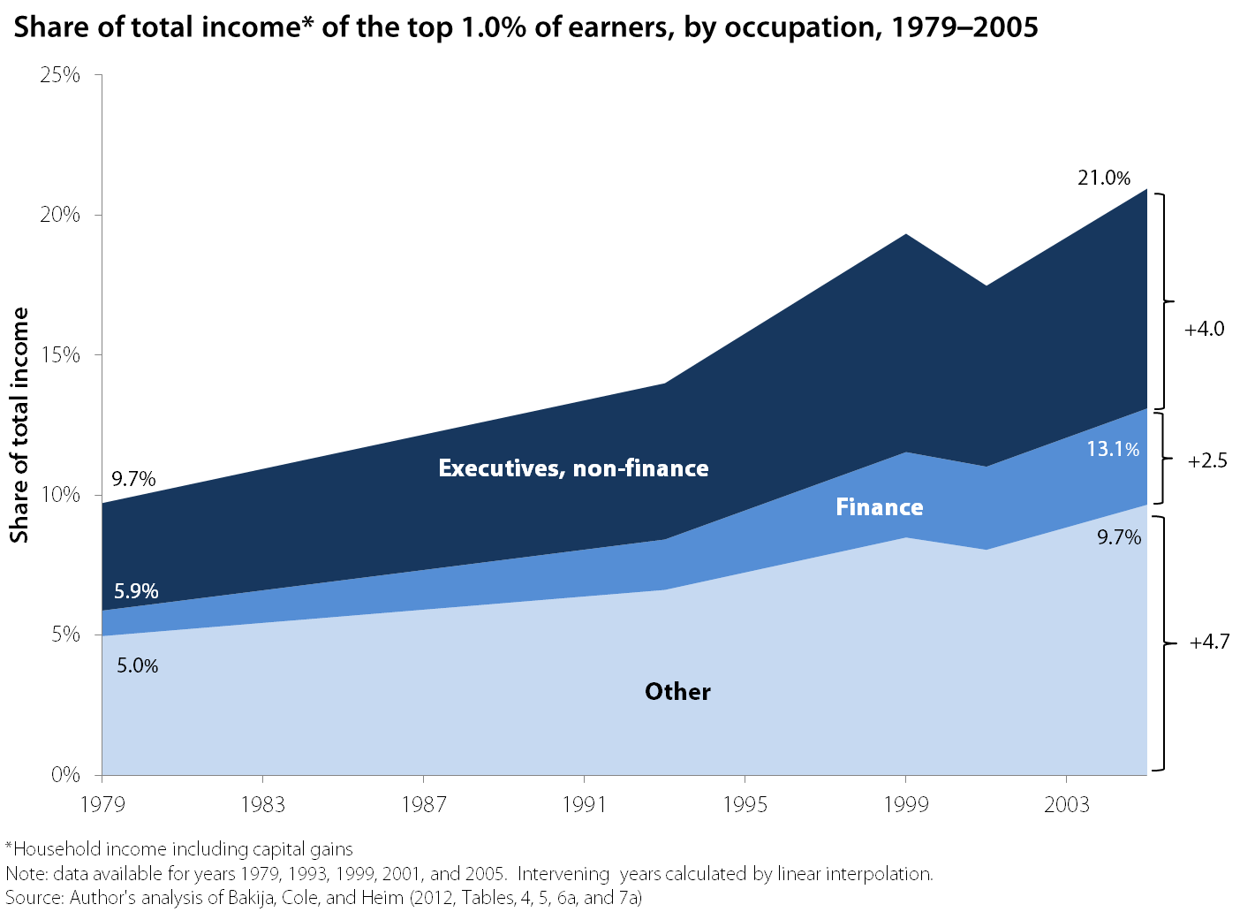

Slide 26
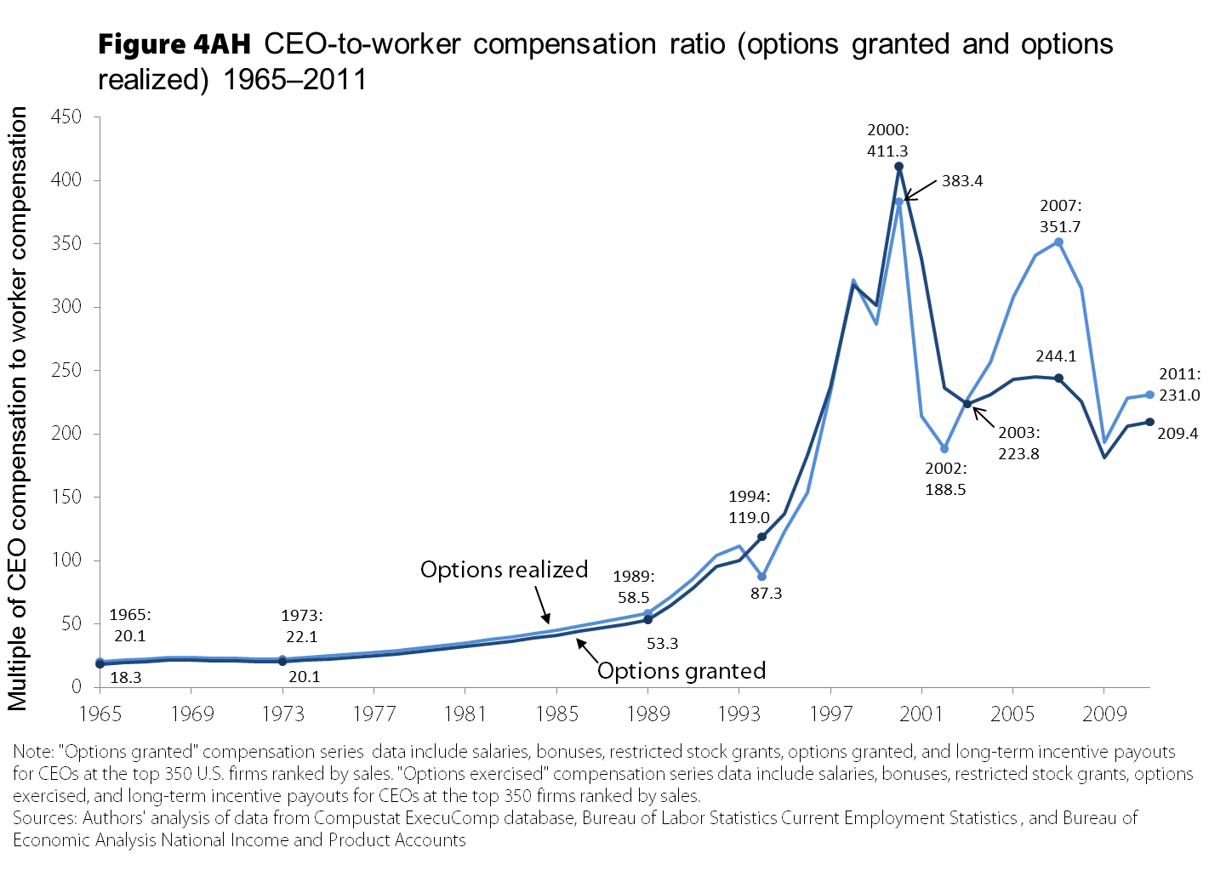

Slide 27
Explaining middle/bottom
wage gap

Slide 28
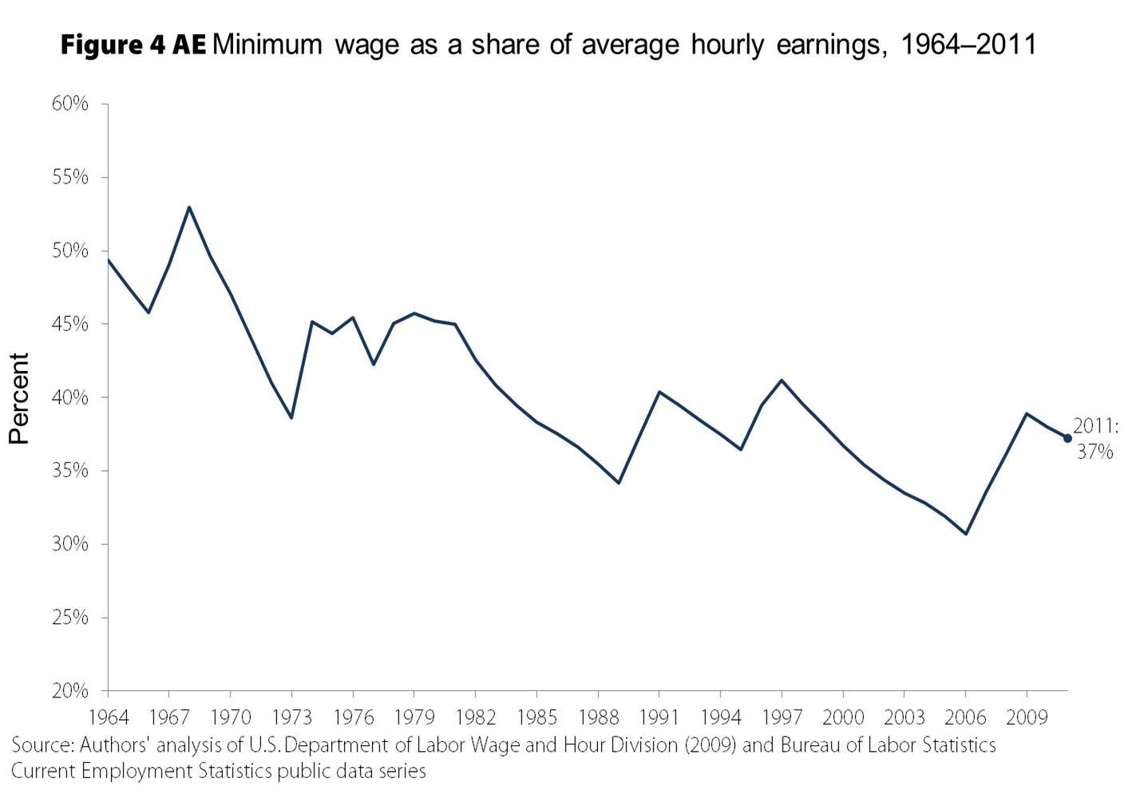
Explains 57% of the overall increase in the “50/10 wage gap” between 1979 and 2011, 66% of the female 50/10 wage gap.

Slide 29
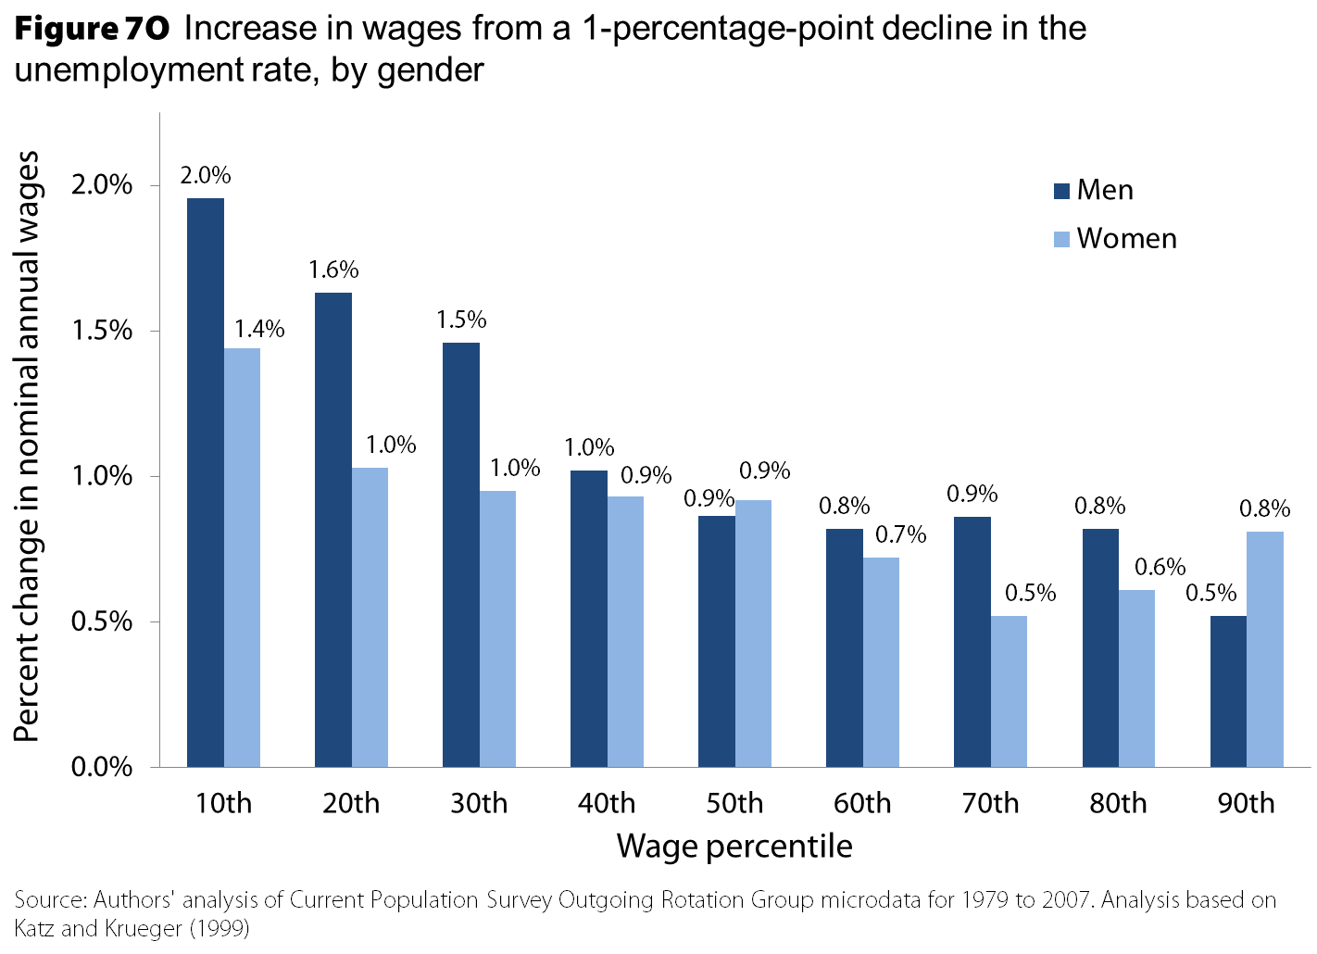

Slide 30
Explaining top/middle
wage gap

Slide 31
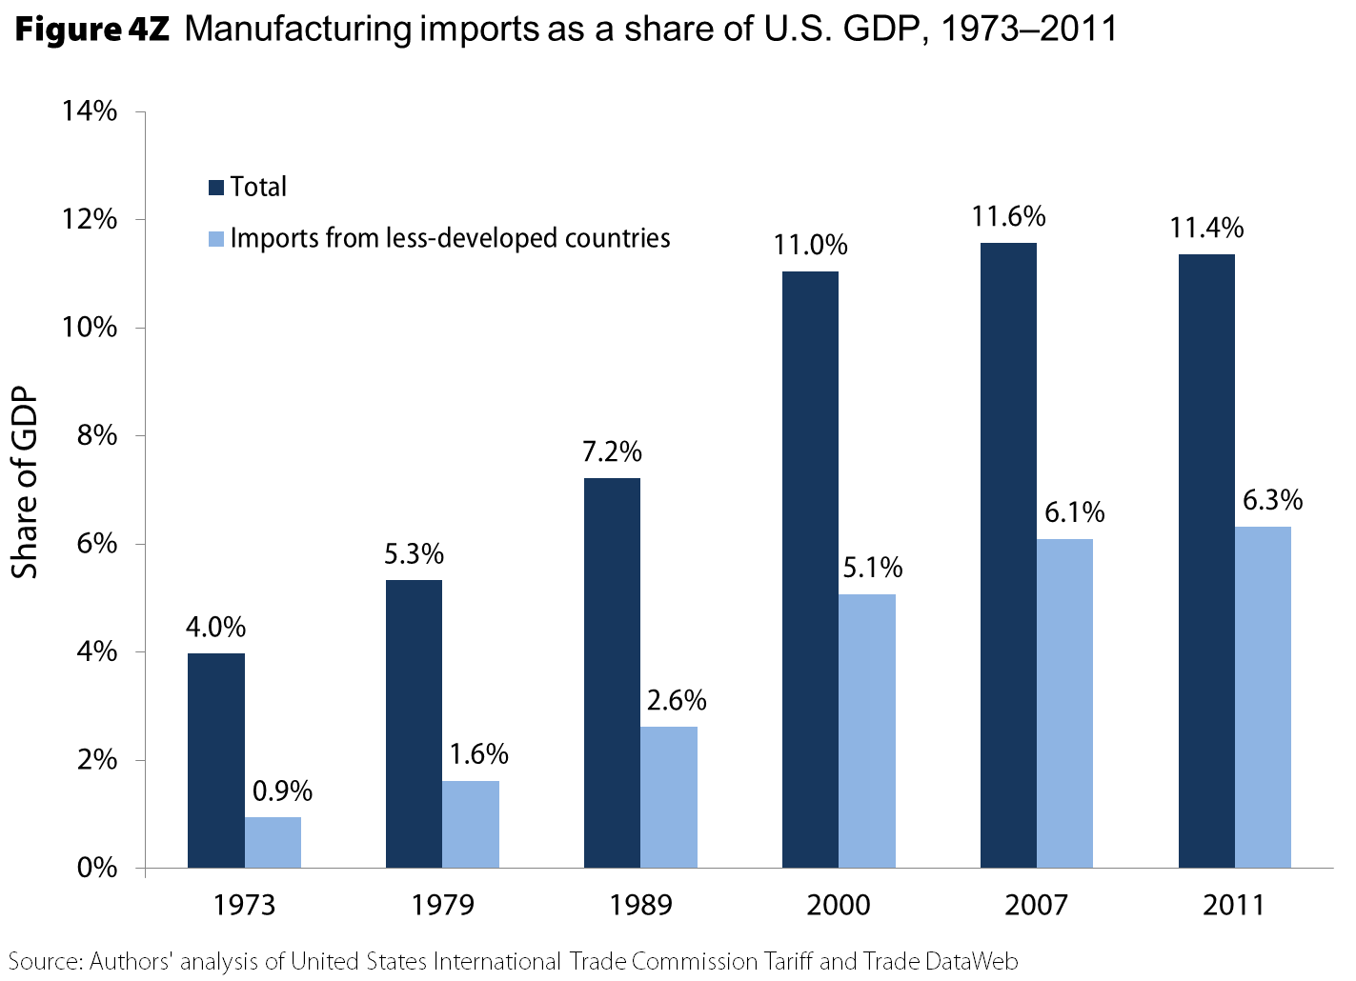
Trade with less developed nations explains a third of the overall rise in the college premium between 1979 and 2011 – but explains 90% of the increase post-1995.

Slide 32
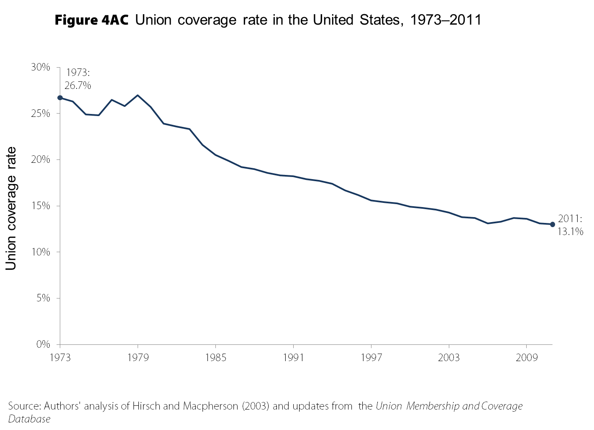
Explains a third of the increase in male wage inequality, and 20% of the increase in women’s wage inequality*.
*Wage inequality as measured by the log variance of the wage distribution.

Slide 33
What else is in State of Working America?
Evidence on how there is no “skills-gap” and why inequality is not about lagging education
Evidence on deep poverty reaching its highest rate in recorded history in 2010
Evidence that the US today is not a mobile society – relative to its own history or its international peers
Evidence that there has been no “democratization” of the stock market
Evidence on that Social Security and Medicare have contributed more to middle-income growth than wages and salaries over the past generation

Slide 34
Favorites section

Slide 36
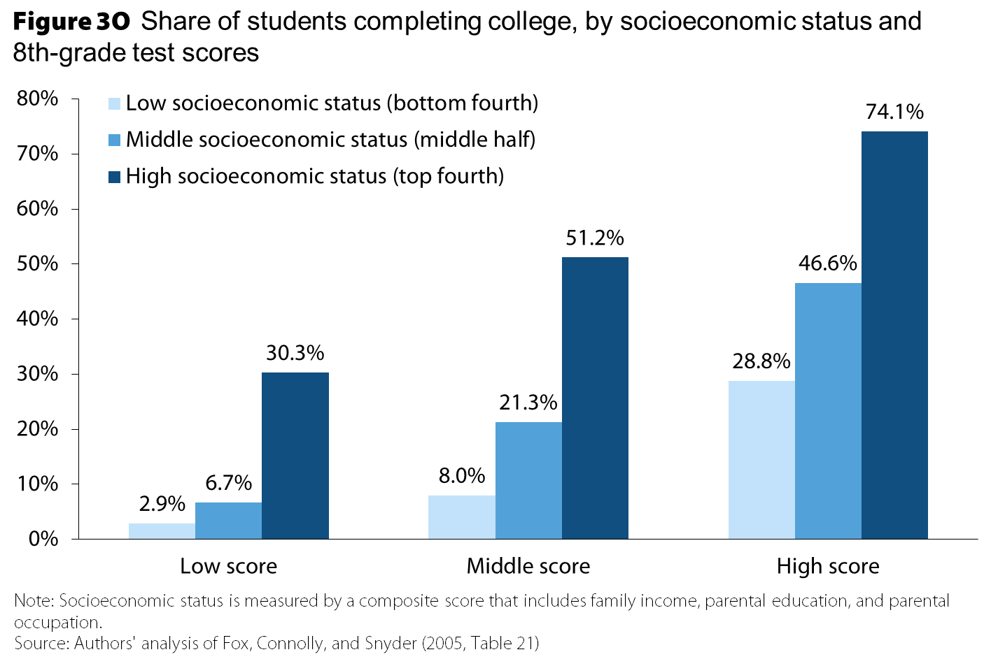

Slide 37
